Slide 1
Java™ How to Program, 9/e
© Copyright 1992-2012 by Pearson Education, Inc. All Rights Reserved.

Slide 3
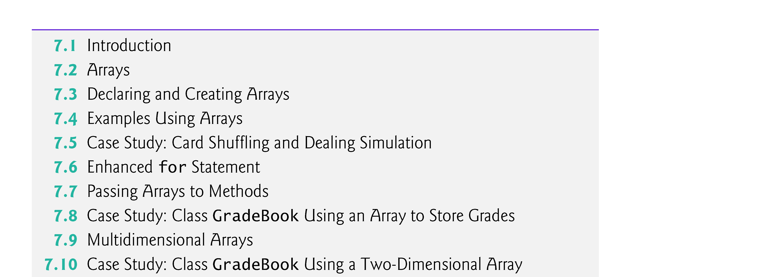
© Copyright 1992-2012 by Pearson Education, Inc. All Rights Reserved.

Slide 4

Data structures
  Collections of related data items.
  Discussed in depth in Chapters 20–22.
Arrays
  Data structures consisting of related data items of the same type.
  Make it convenient to process related groups of values.
  Remain the same length once they are created.
Enhanced for statement for iterating over an array or collection of data items.
Variable-length argument lists
  Can create methods are with varying numbers of arguments.
Process command-line arguments in method main.
© Copyright 1992-2012 by Pearson Education, Inc. All Rights Reserved.

Slide 5

Common array manipulations with static methods of class Arrays from the java.util package.
ArrayList collection
  Similar to arrays
  Dynamic resizing
    They automatically increase their size at execution time to accommodate additional elements
© Copyright 1992-2012 by Pearson Education, Inc. All Rights Reserved.

Slide 6
Array
  Group of variables (called elements) containing values of the same type.
  Arrays are objects so they are reference types.
  Elements can be either primitive or reference types.
Refer to a particular element in an array
  Use the element’s index.
  Array-access expression—the name of the array followed by the index of the particular element in square brackets, [].
The first element in every array has index zero.
The highest index in an array is one less than the number of elements in the array.
Array names follow the same conventions as other variable names.
© Copyright 1992-2012 by Pearson Education, Inc. All Rights Reserved.

Slide 7
© Copyright 1992-2012 by Pearson Education, Inc. All Rights Reserved.

Slide 8
An index must be a nonnegative integer.
  Can use an expression as an index.
An indexed array name is an array-access expression.
  Can be used on the left side of an assignment to place a new value into an array element.
Every array object knows its own length and stores it in a length instance variable.
  length cannot be changed because it’s a final variable.
© Copyright 1992-2012 by Pearson Education, Inc. All Rights Reserved.

Slide 9
© Copyright 1992-2012 by Pearson Education, Inc. All Rights Reserved.

Slide 10
Array objects
  Created with keyword new.
  You specify the element type and the number of elements in an array-creation expression, which returns a reference that can be stored in an array variable.
Declaration and array-creation expression for an array of 12 int elements
    int[] c = new int[ 12 ];
Can be performed in two steps as follows:
    int[] c; // declare the array variable
    c = new int[ 12 ]; // creates the array
© Copyright 1992-2012 by Pearson Education, Inc. All Rights Reserved.

Slide 11
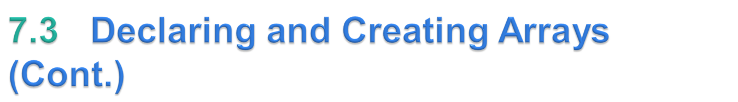
In a declaration, square brackets following a type indicate that a variable will refer to an array (i.e., store an array reference).
When an array is created, each element of the array receives a default value
  Zero for the numeric primitive-type elements, false for boolean elements and null for references.
© Copyright 1992-2012 by Pearson Education, Inc. All Rights Reserved.

Slide 12
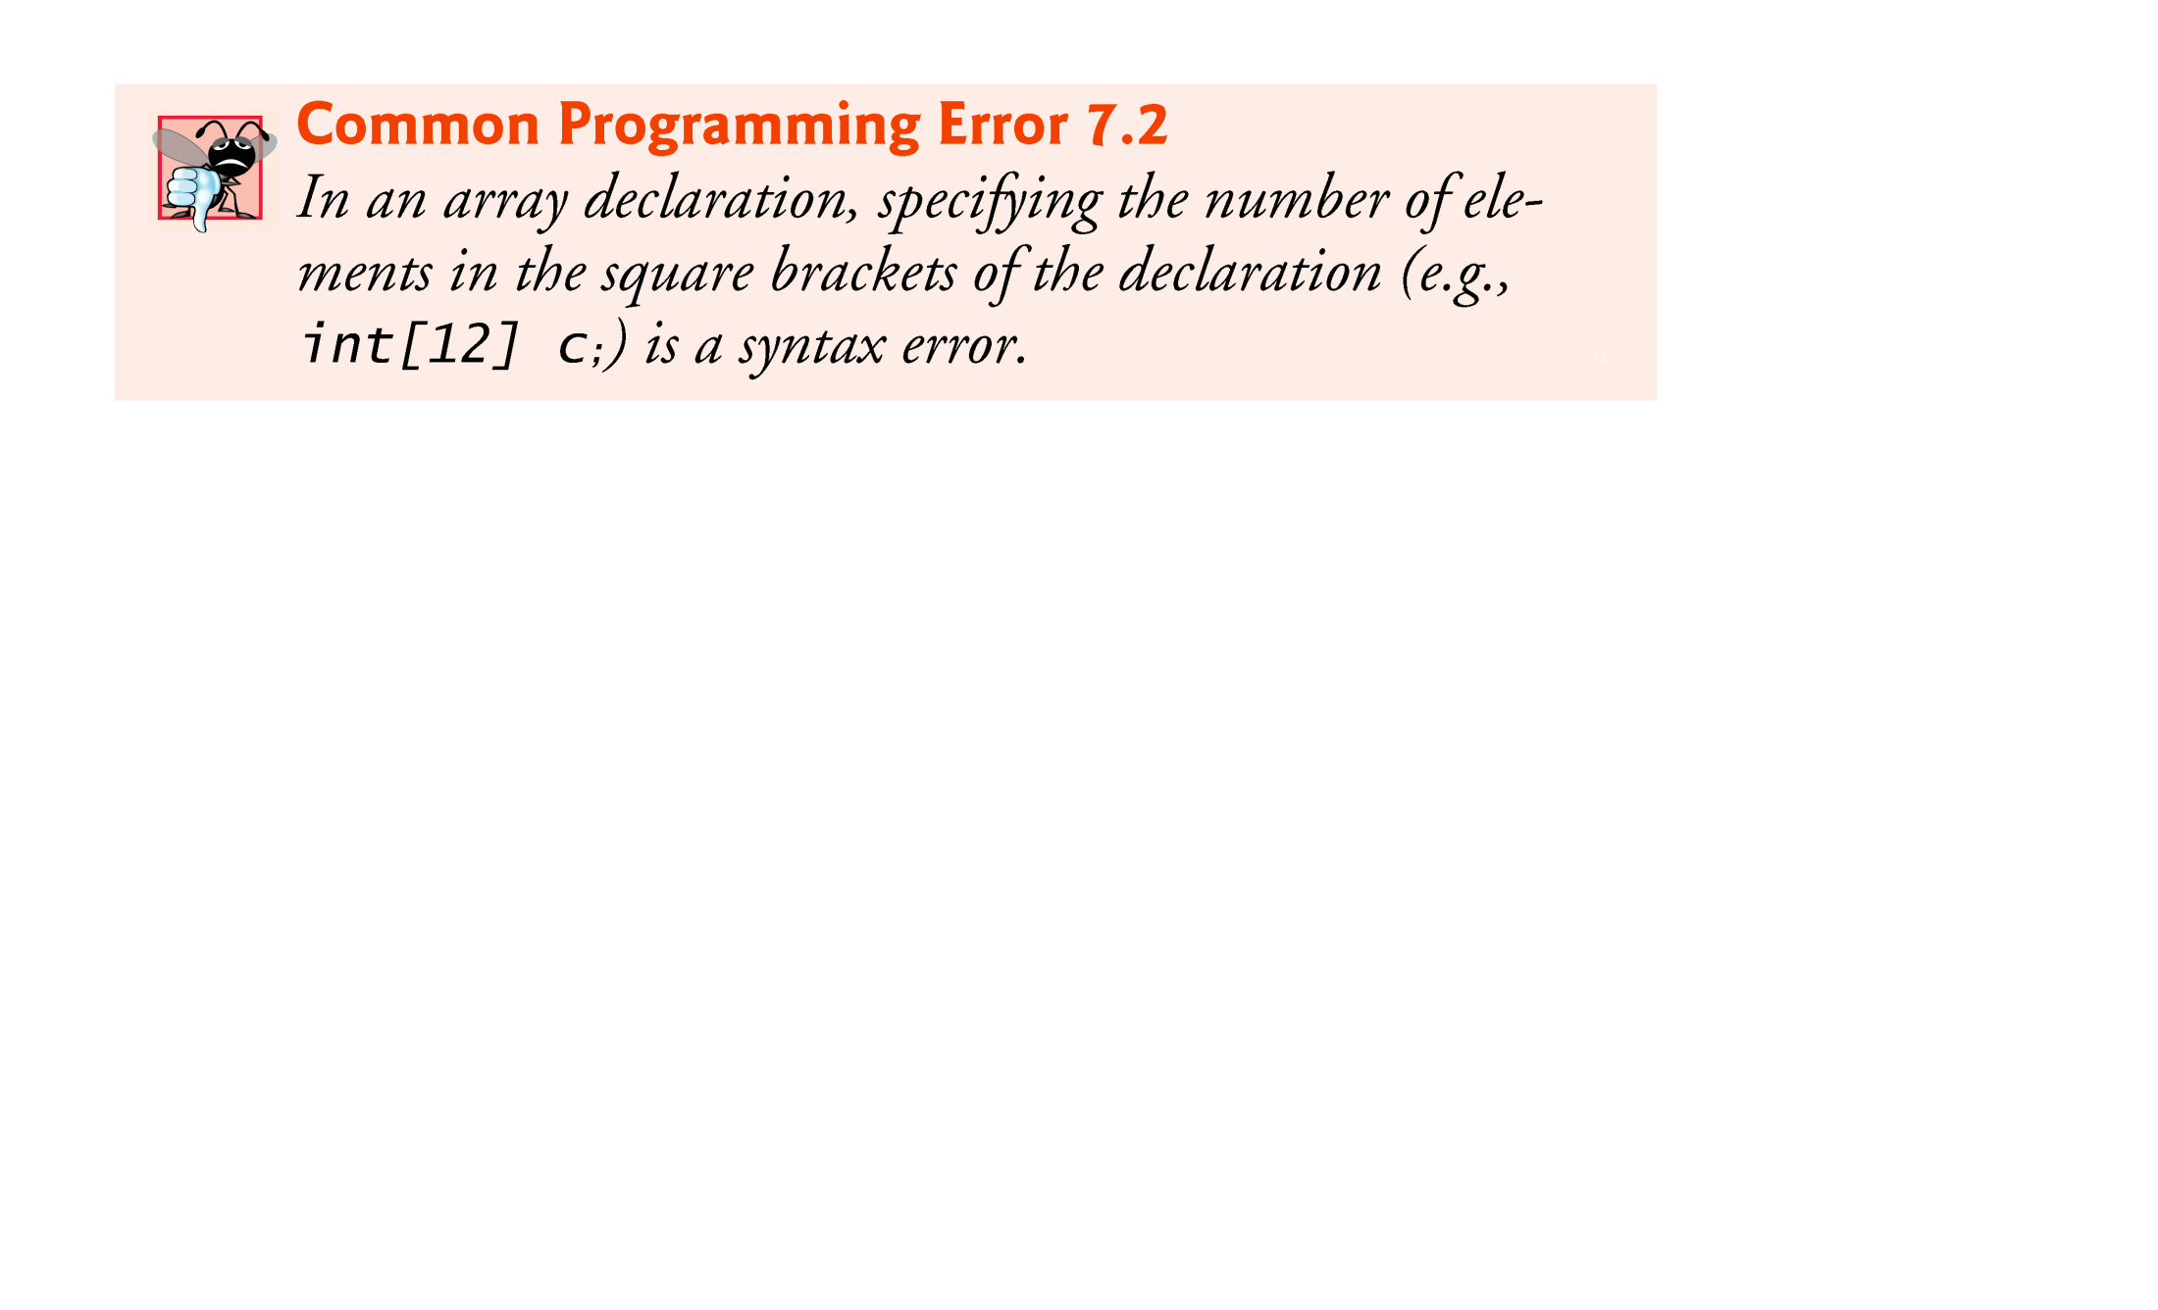
© Copyright 1992-2012 by Pearson Education, Inc. All Rights Reserved.

Slide 13
When the element type and the square brackets are combined at the beginning of the declaration, all the identifiers in the declaration are array variables.
  E.g. int [] arr1, arr2; // both arr1 and arr2 are arrays
For readability, declare only one variable per declaration.
© Copyright 1992-2012 by Pearson Education, Inc. All Rights Reserved.

Slide 14
© Copyright 1992-2012 by Pearson Education, Inc. All Rights Reserved.

Slide 15
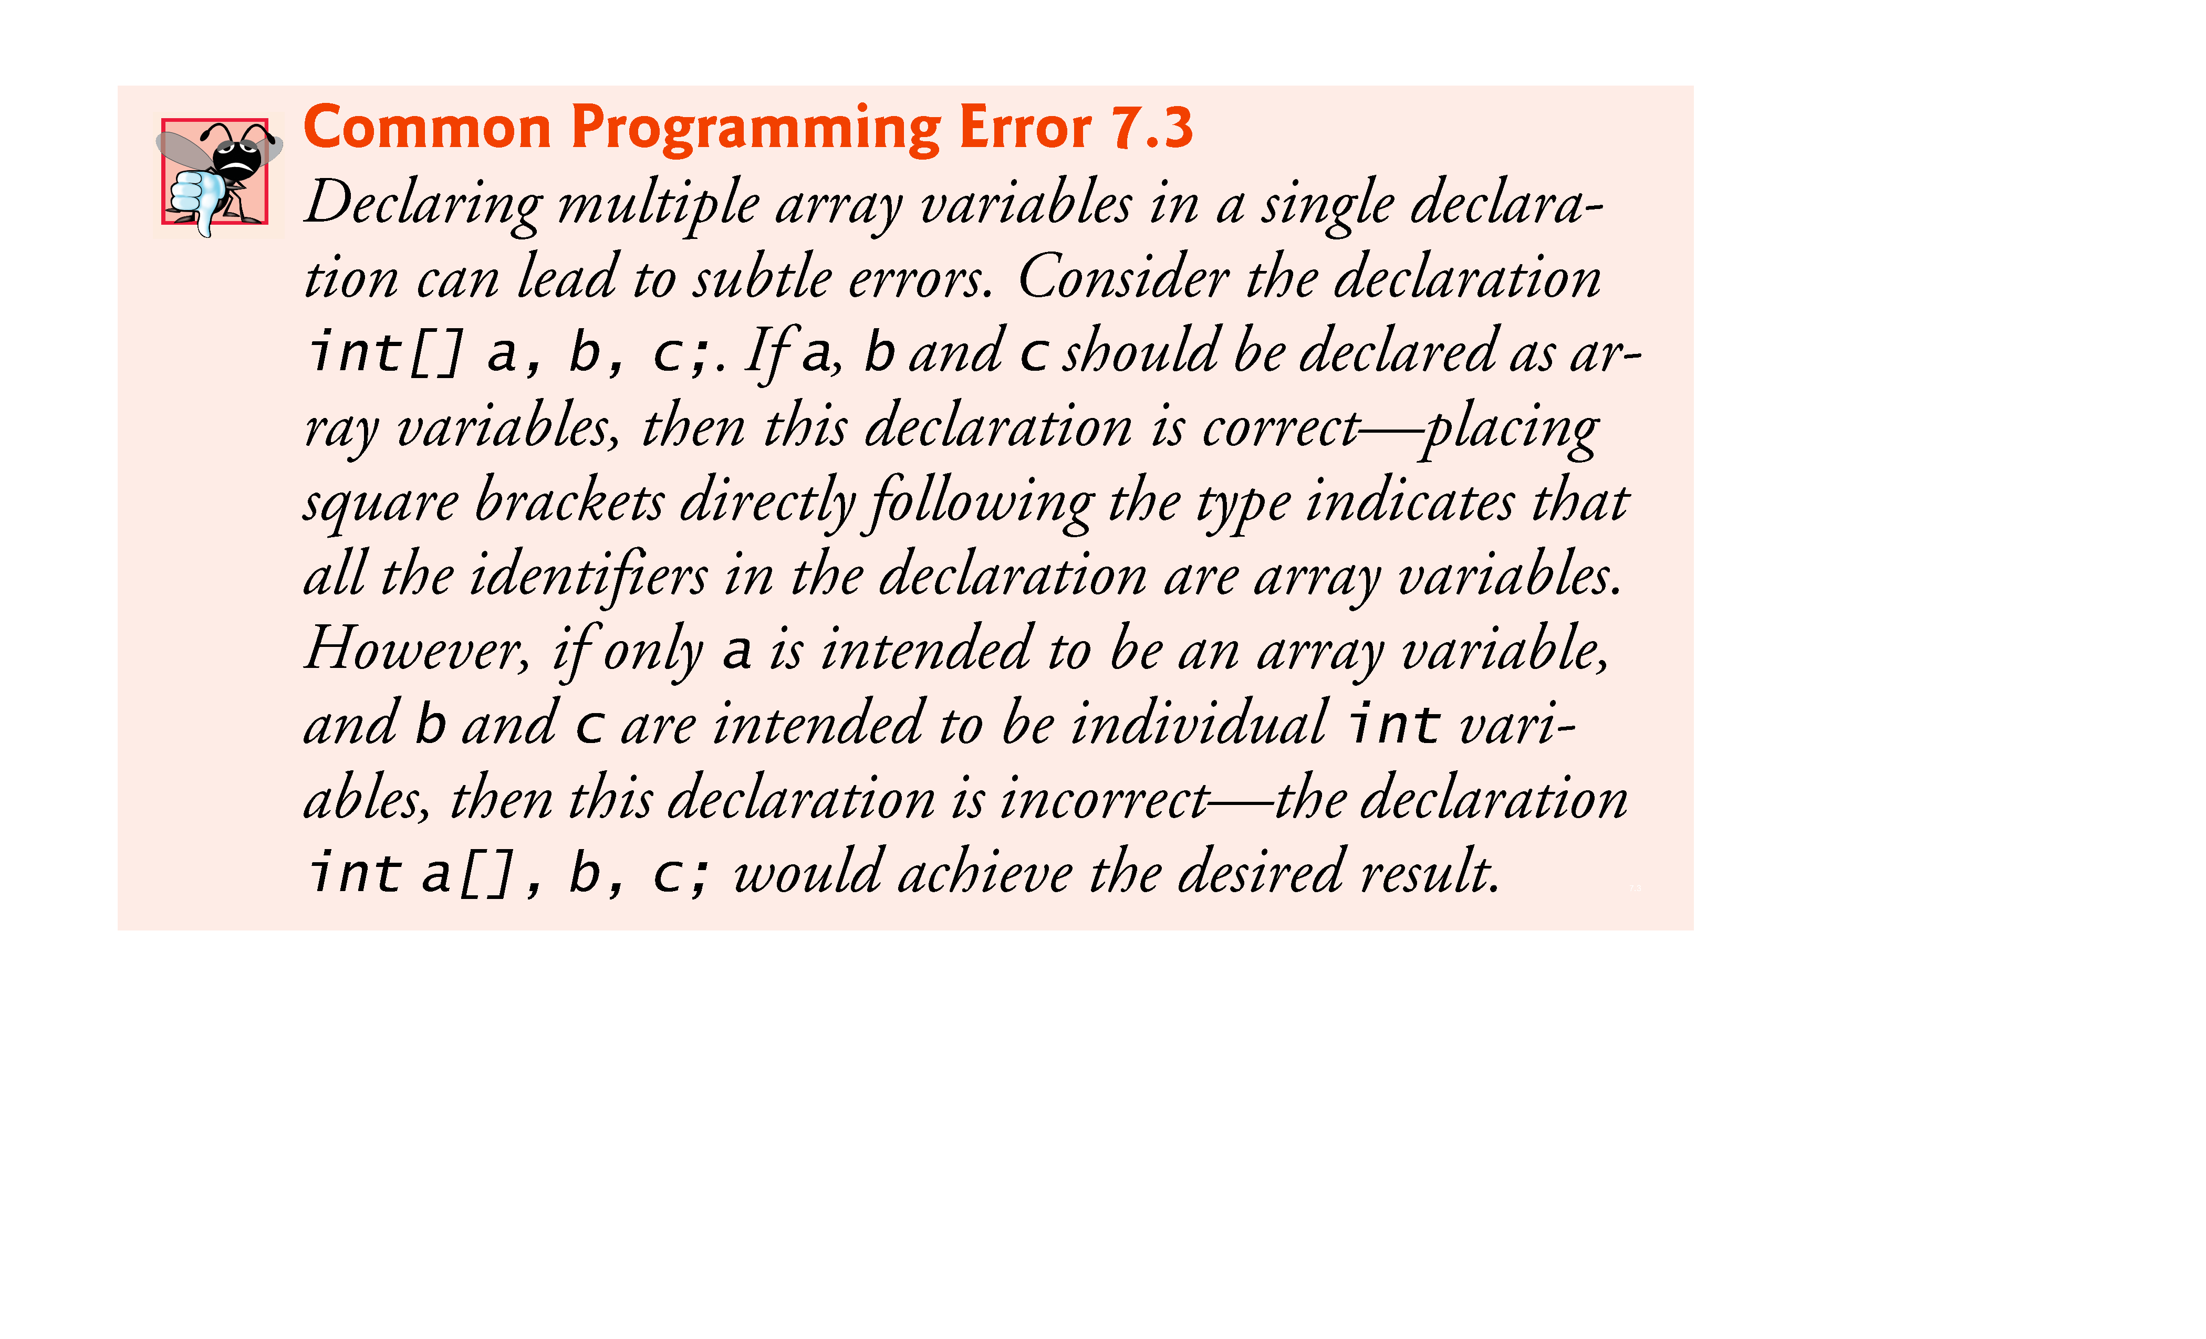
© Copyright 1992-2012 by Pearson Education, Inc. All Rights Reserved.

Slide 16
Every element of a primitive-type array contains a value of the array’s declared element type.
  Every element of an int array is an int value.
Every element of a reference-type array is a reference to an object of the array’s declared element type.
  Every element of a String array is a reference to a String object.
© Copyright 1992-2012 by Pearson Education, Inc. All Rights Reserved.

Slide 17

Fig. 7.2 uses keyword new to create an array of 10 int elements, which are initially zero (the default for int variables).
© Copyright 1992-2012 by Pearson Education, Inc. All Rights Reserved.

Slide 18
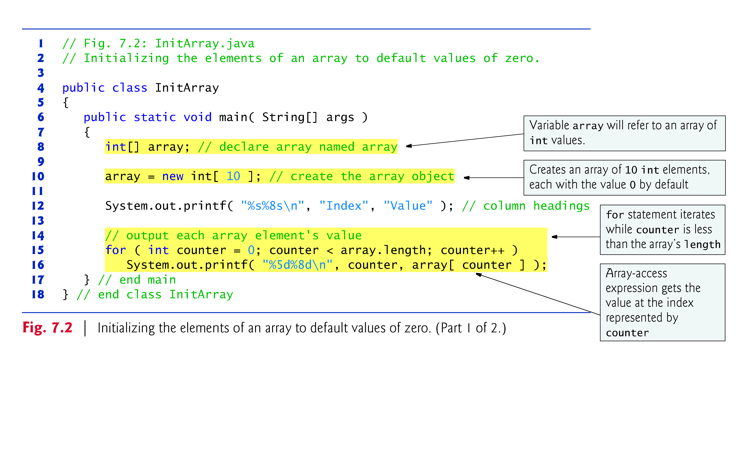
© Copyright 1992-2012 by Pearson Education, Inc. All Rights Reserved.

Slide 19
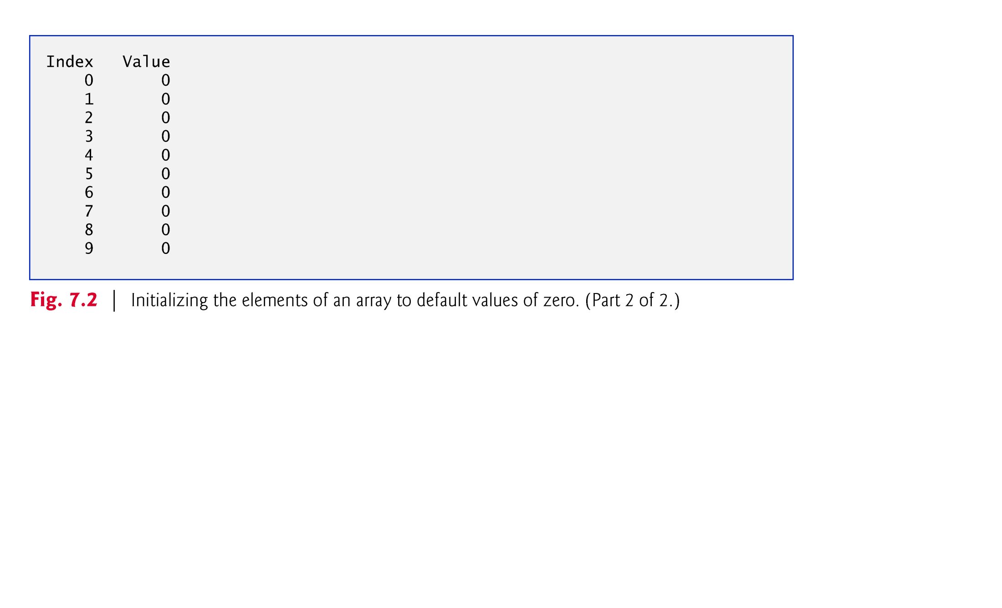
© Copyright 1992-2012 by Pearson Education, Inc. All Rights Reserved.

Slide 20
Array initializer
  A comma-separated list of expressions (called an initializer list) enclosed in braces.
  Used to create an array and initialize its elements.
  Array length is determined by the number of elements in the initializer list.
    int[] n = { 10, 20, 30, 40, 50 };
    Creates a five-element array with index values 0–4.
Compiler counts the number of initializers in the list to determine the size of the array
  Sets up the appropriate new operation “behind the scenes.”
© Copyright 1992-2012 by Pearson Education, Inc. All Rights Reserved.

Slide 21
© Copyright 1992-2012 by Pearson Education, Inc. All Rights Reserved.

Slide 22
© Copyright 1992-2012 by Pearson Education, Inc. All Rights Reserved.

Slide 23
The application in Fig. 7.4 creates a 10-element array and assigns to each element one of the even integers from 2 to 20 (2, 4, 6, …, 20).
© Copyright 1992-2012 by Pearson Education, Inc. All Rights Reserved.

Slide 25
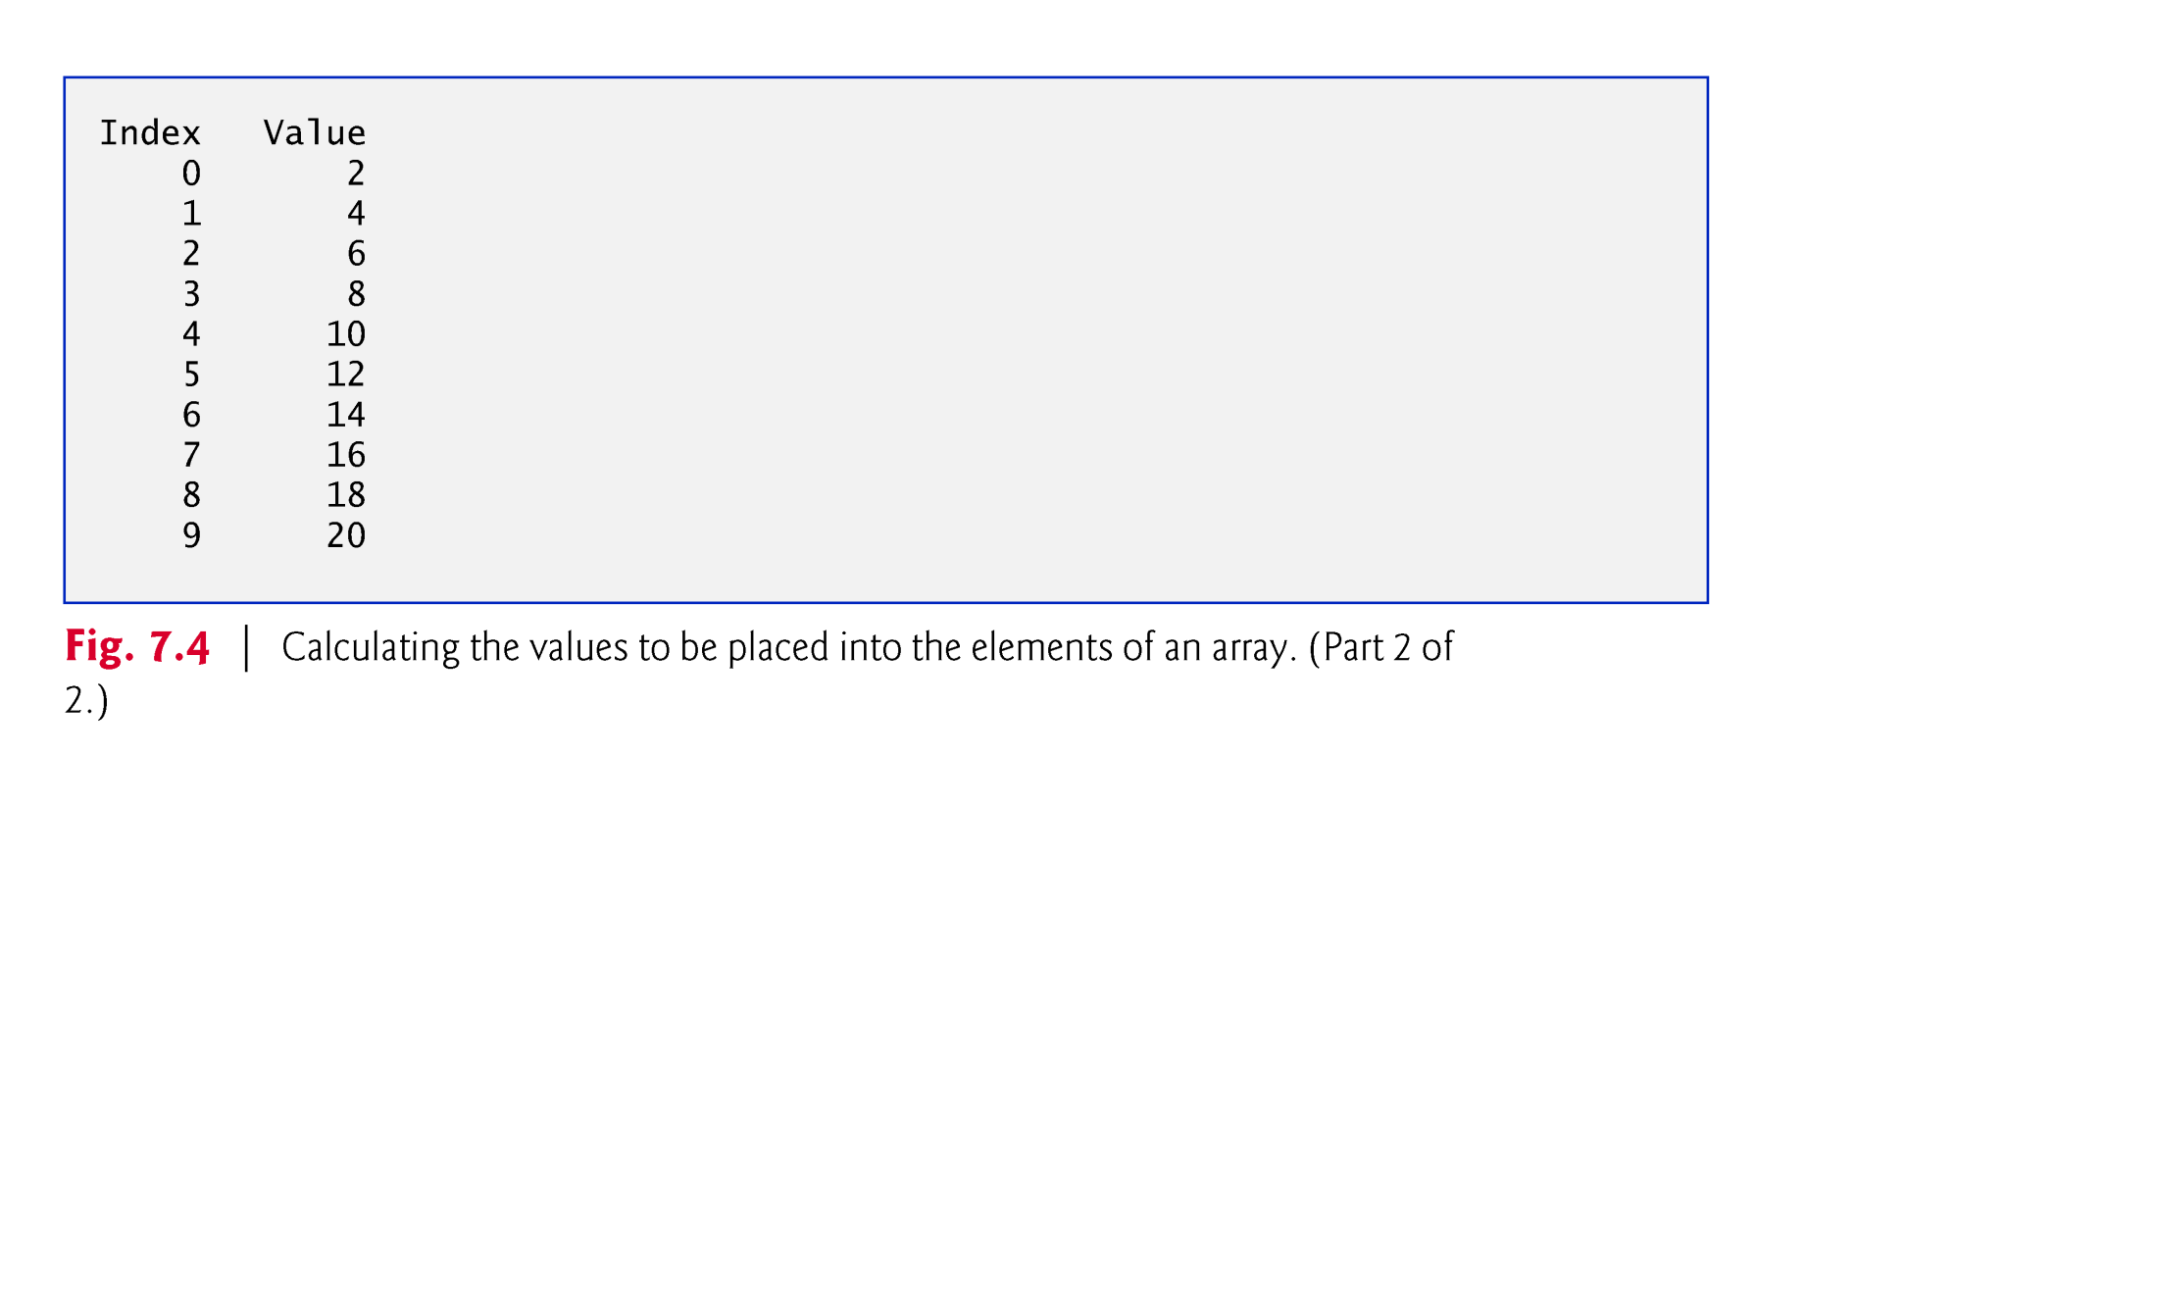

Slide 26
final variables must be initialized before they are used and cannot be modified thereafter.
An attempt to modify a final variable after it’s initialized causes a compilation error
    cannot assign a value to final variable variableName
An attempt to access the value of a final variable before it’s initialized causes a compilation error
    variable variableName might not have been initialized
© Copyright 1992-2012 by Pearson Education, Inc. All Rights Reserved.

Slide 27
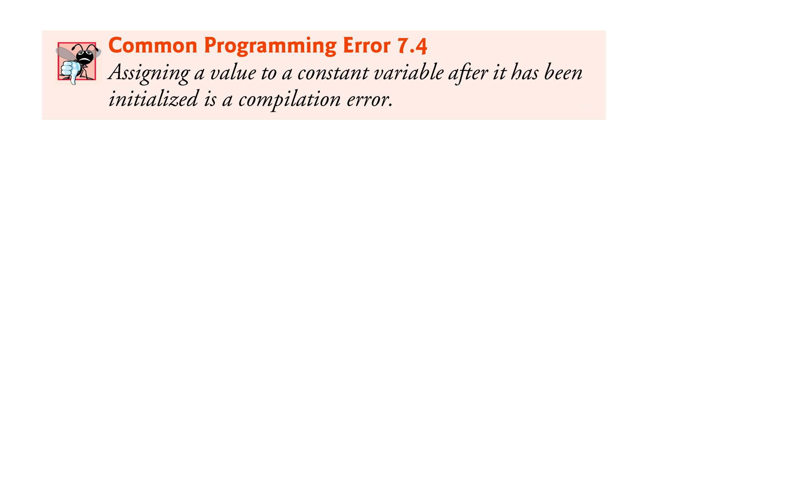
© Copyright 1992-2012 by Pearson Education, Inc. All Rights Reserved.

Slide 28

© Copyright 1992-2012 by Pearson Education, Inc. All Rights Reserved.

Slide 29
Figure 7.5 sums the values contained in a 10-element integer array.
Often, the elements of an array represent a series of values to be used in a calculation.
© Copyright 1992-2012 by Pearson Education, Inc. All Rights Reserved.

Slide 30
© Copyright 1992-2012 by Pearson Education, Inc. All Rights Reserved.

Slide 31
Many programs present data to users in a graphical manner.
Numeric values are often displayed as bars in a bar chart.
  Longer bars represent proportionally larger numeric values.
A simple way to display numeric data is with a bar chart that shows each numeric value as a bar of asterisks (*).
Format specifier %02d indicates that an int value should be formatted as a field of two digits.
  The 0 flag displays a leading 0 for values with fewer digits than the field width (2).
© Copyright 1992-2012 by Pearson Education, Inc. All Rights Reserved.

Slide 32
© Copyright 1992-2012 by Pearson Education, Inc. All Rights Reserved.

Slide 33
© Copyright 1992-2012 by Pearson Education, Inc. All Rights Reserved.

Slide 34
Sometimes, programs use counter variables to summarize data, such as the results of a survey.
Fig. 6.7 used separate counters in a die-rolling program to track the number of occurrences of each side of a six-sided die as the program rolled the die 6,000,000 times.
Fig. 7.7 shows an array version of this application.
  Line 14 of this program replaces lines 23–46 of Fig. 6.7.
Array frequency must be large enough to store six counters.
  We use a seven-element array in which we ignore frequency[0]
  More logical to have the face value 1 increment frequency[1] than frequency[0].
© Copyright 1992-2012 by Pearson Education, Inc. All Rights Reserved.

Slide 36
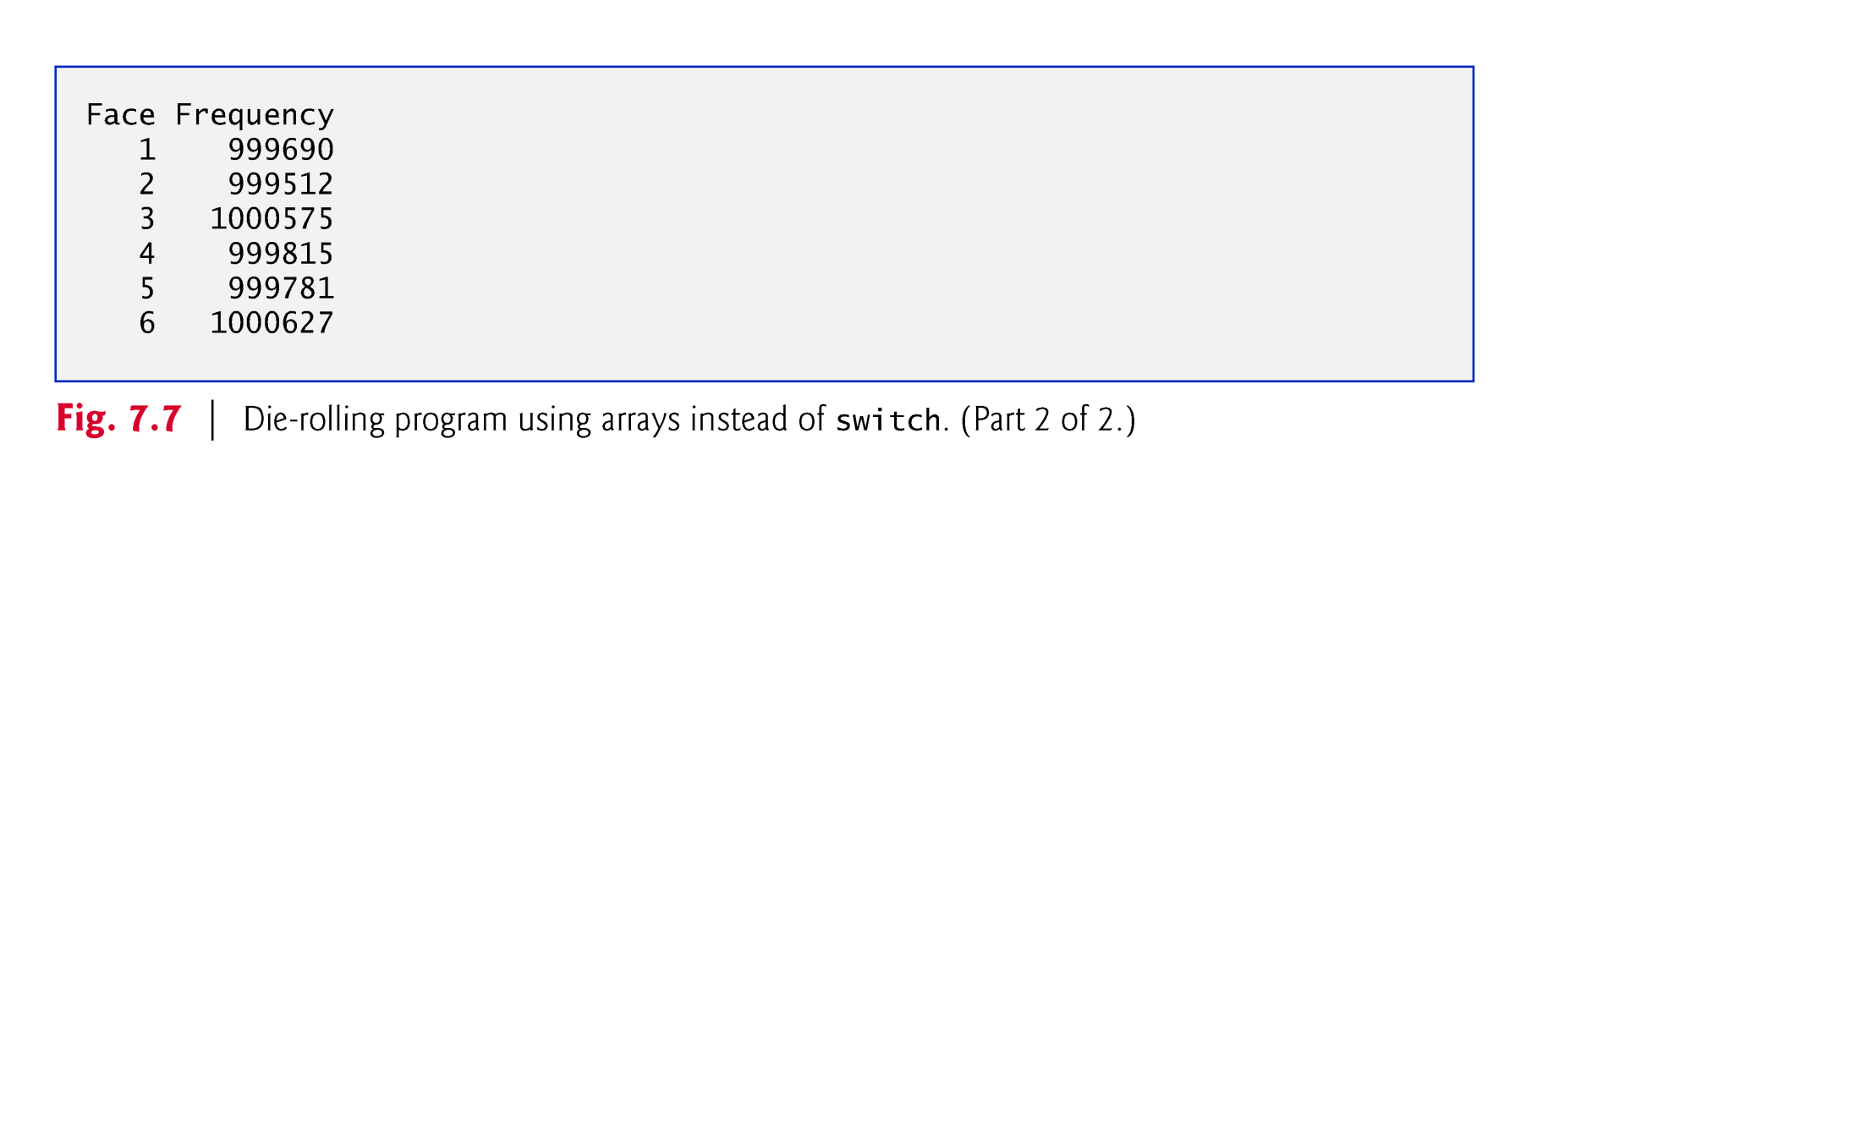

Slide 37
Read Case Study 7.5 yourself from the book: Card Shuffling and Dealing Simulation
© Copyright 1992-2012 by Pearson Education, Inc. All Rights Reserved.

Slide 38

Enhanced for statement
  Iterates through the elements of an array without using a counter.
  Avoids the possibility of “stepping outside” the array.
  Also works with the Java API’s prebuilt collections (see Section 7.14).
Syntax:
    for ( parameter : arrayName )
    statement
where parameter has a type and an identifier and arrayName is the array through which to iterate.
Parameter type must be consistent with the array’s element type.
The enhanced for statement simplifies the code for iterating through an array.
© Copyright 1992-2012 by Pearson Education, Inc. All Rights Reserved.

Slide 40
The enhanced for statement can be used only to obtain array elements
  It cannot be used to modify elements.
  To modify elements, use the traditional counter-controlled for statement.
Can be used in place of the counter-controlled for statement if you don’t need to access the index of the element.
© Copyright 1992-2012 by Pearson Education, Inc. All Rights Reserved.

Slide 41

To pass an array argument to a method, specify the name of the array without any brackets.
  Since every array object “knows” its own length, we need not pass the array length as an additional argument.
To receive an array, the method’s parameter list must specify an array parameter.
© Copyright 1992-2012 by Pearson Education, Inc. All Rights Reserved.

Slide 42
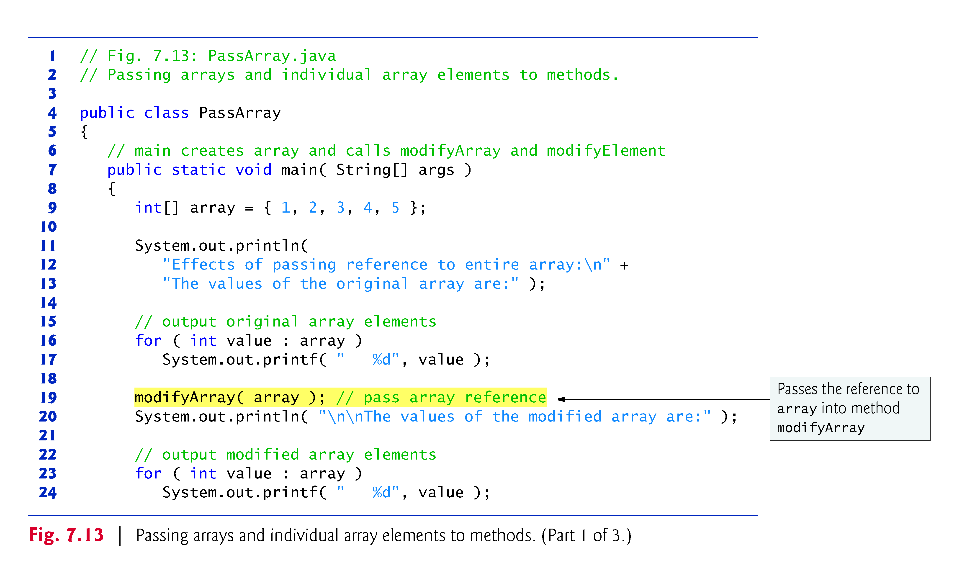
© Copyright 1992-2012 by Pearson Education, Inc. All Rights Reserved.

Slide 43
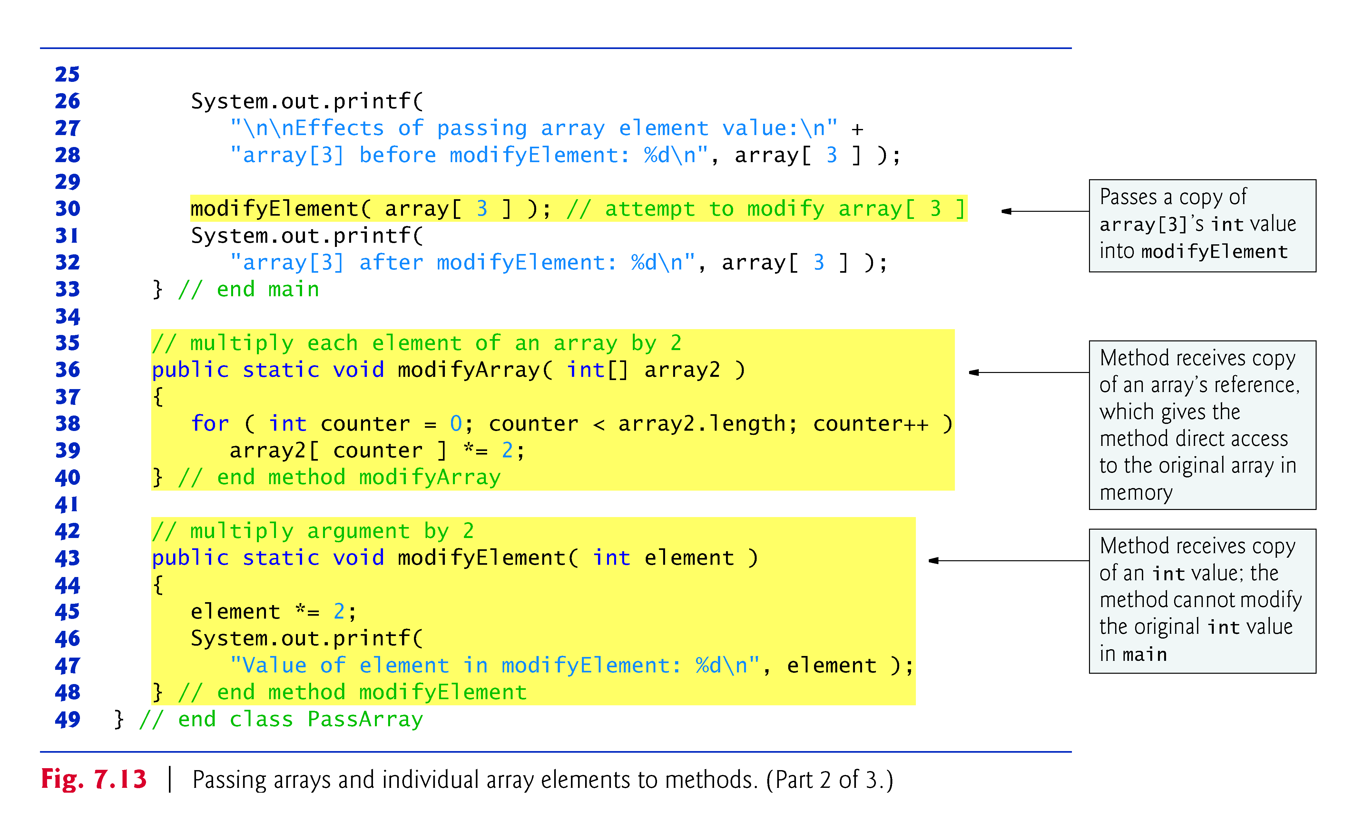
© Copyright 1992-2012 by Pearson Education, Inc. All Rights Reserved.

Slide 44
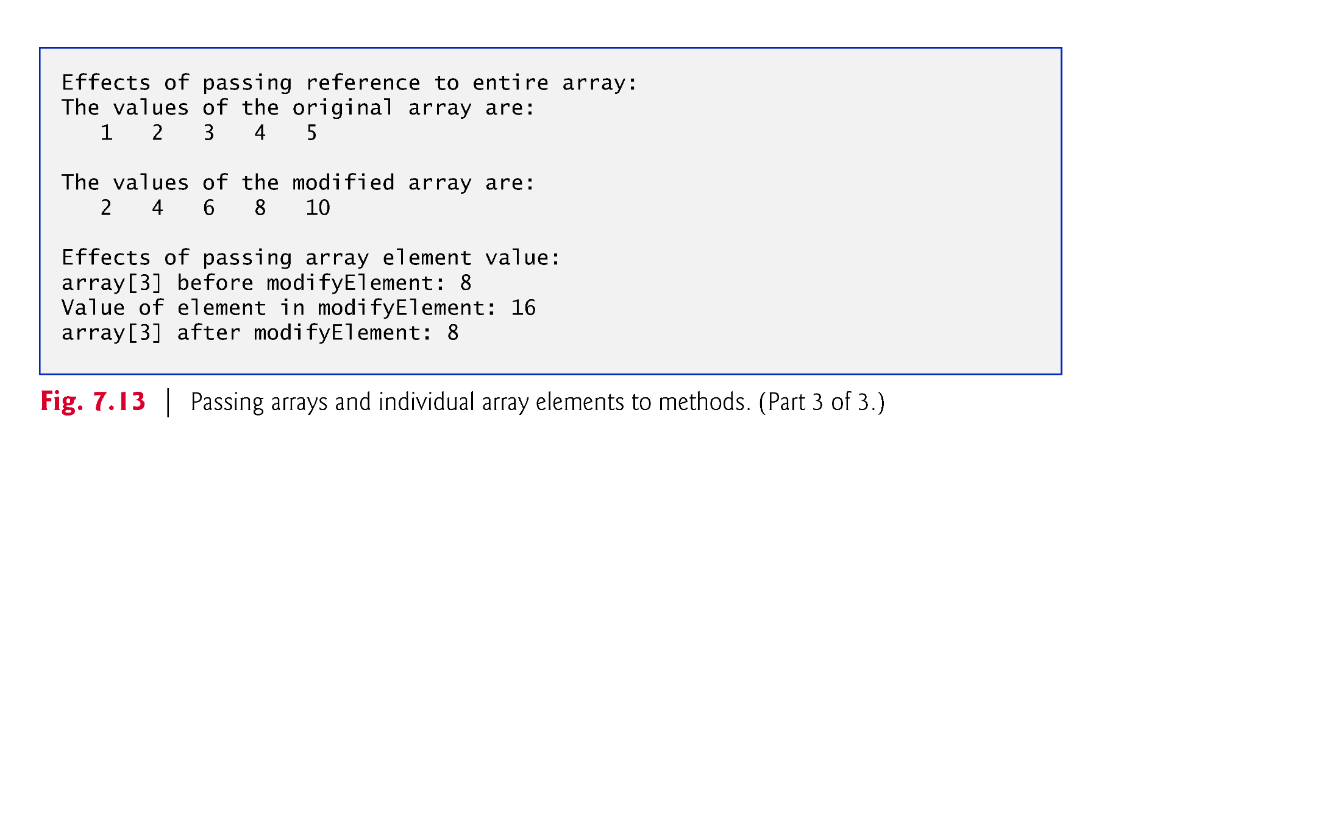
© Copyright 1992-2012 by Pearson Education, Inc. All Rights Reserved.

Slide 45
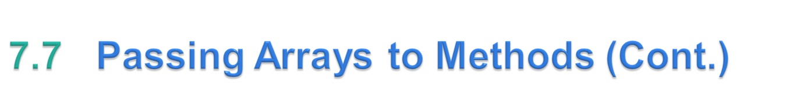
Pass-by-value (also called call-by-value)
  When an argument to a method is an individual array element of a primitive type, the called method receives a copy of the element’s value.
  A copy of the argument’s value is passed to the called method.
  The called method works exclusively with the copy.
  Changes to the called method’s copy do not affect the original variable’s value in the caller.
© Copyright 1992-2012 by Pearson Education, Inc. All Rights Reserved.

Slide 46
Pass-by-reference (also called call-by-reference)
  When an argument to a method is an entire array or an individual array element of a reference type, the called method receives a copy of the reference.
  The called method can access the argument’s value in the caller directly and modify that data, if necessary.
  Improves performance by eliminating the need to copy possibly large amounts of data.
© Copyright 1992-2012 by Pearson Education, Inc. All Rights Reserved.

Slide 47
All arguments in Java are ACTUALLY passed by value.
A method call can pass two types of values to a method
  Copies of primitive values
  Copies of references to objects
Objects cannot be passed to methods.
If a method modifies a reference-type parameter so that it refers to another object, only the parameter refers to the new object
  The reference stored in the caller’s variable still refers to the original object.
© Copyright 1992-2012 by Pearson Education, Inc. All Rights Reserved.

Slide 48

public class OtherClass {
public String message;
public OtherClass(String input) {
message = input;
}
}
© Copyright 1992-2012 by Pearson Education, Inc. All Rights Reserved.

Slide 49

public class HelloWorld {
public static void main(String[] args) {
OtherClass myObject = new OtherClass("Hello World!");
System.out.println(myObject.message);
passObject(myObject);
System.out.println(myObject.message);
}
public static void passObject(OtherClass c2) {
c2.message = "A changed message";
}
}
Output:
Hello World!
A changed message
© Copyright 1992-2012 by Pearson Education, Inc. All Rights Reserved.

Slide 50

public class OtherClass {
public String message;
public OtherClass(String input) {
message = input;
}
}
© Copyright 1992-2012 by Pearson Education, Inc. All Rights Reserved.

Slide 51

// our main class becomes a file but the main method is still found
public class HelloWorld {
public static void main(String[] args) {
OtherClass myObject = new OtherClass("Hello World!");
System.out.println(myObject.message);
passObject(myObject);
System.out.println(myObject.message);
}
public static void passObject(OtherClass c2) {
c2 = new OtherClass(“A changed message”):
}
}
Output:
Hello World!
Hello World!
© Copyright 1992-2012 by Pearson Education, Inc. All Rights Reserved.

Slide 52
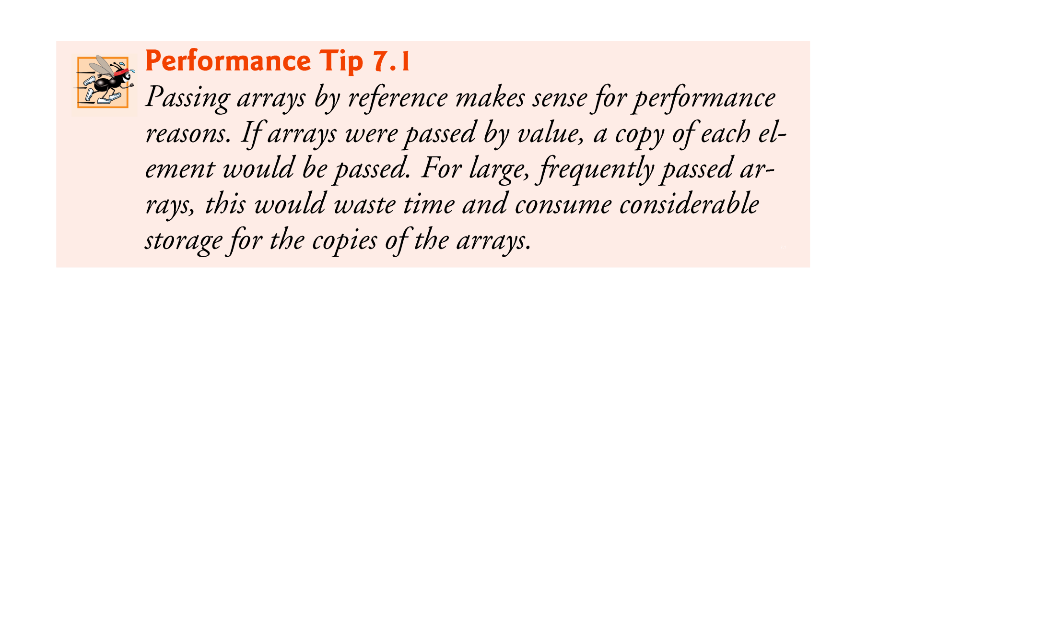
© Copyright 1992-2012 by Pearson Education, Inc. All Rights Reserved.

Slide 53
Previous versions of class GradeBook process a set of grades entered by the user, but do not maintain the individual grade values in instance variables of the class.
  Repeat calculations require the user to reenter the same grades.
  We solve this problem by storing grades in an array.
The grades array’s size is determined by the length of the array that is passed to the constructor.
  So a GradeBook object can process a variable number of grades.
© Copyright 1992-2012 by Pearson Education, Inc. All Rights Reserved.

Slide 54
© Copyright 1992-2012 by Pearson Education, Inc. All Rights Reserved.

Slide 55
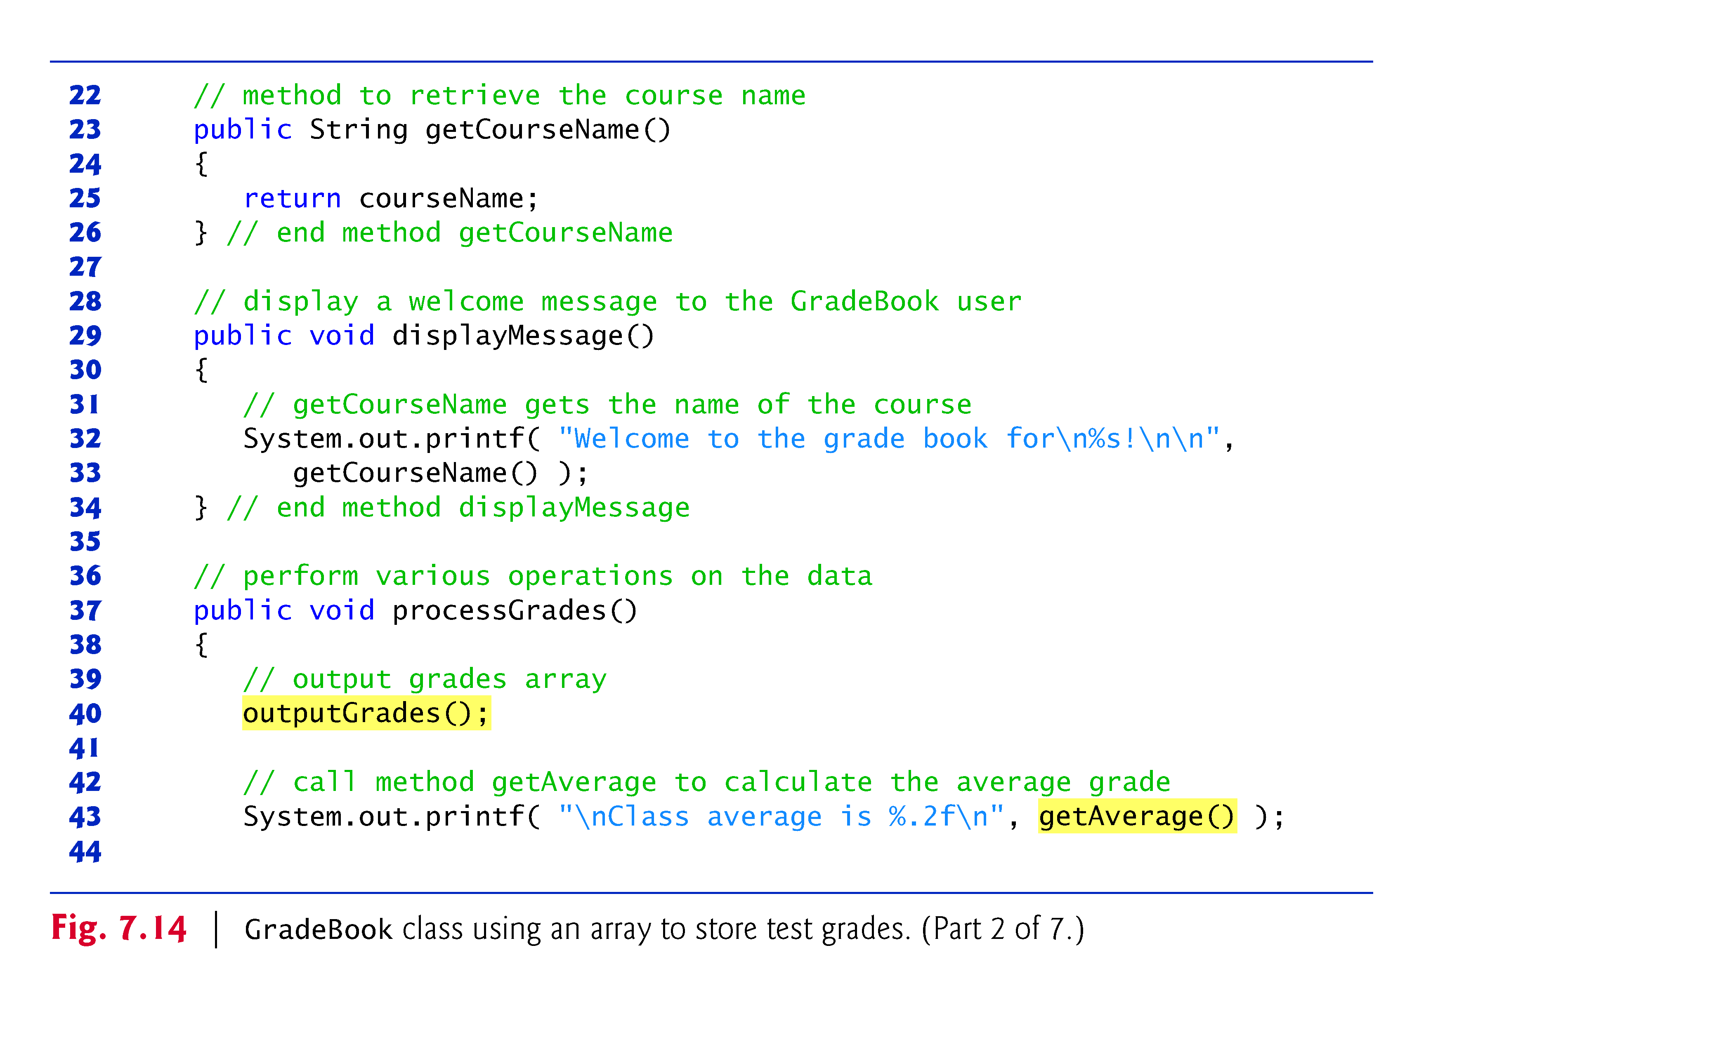
© Copyright 1992-2012 by Pearson Education, Inc. All Rights Reserved.

Slide 56
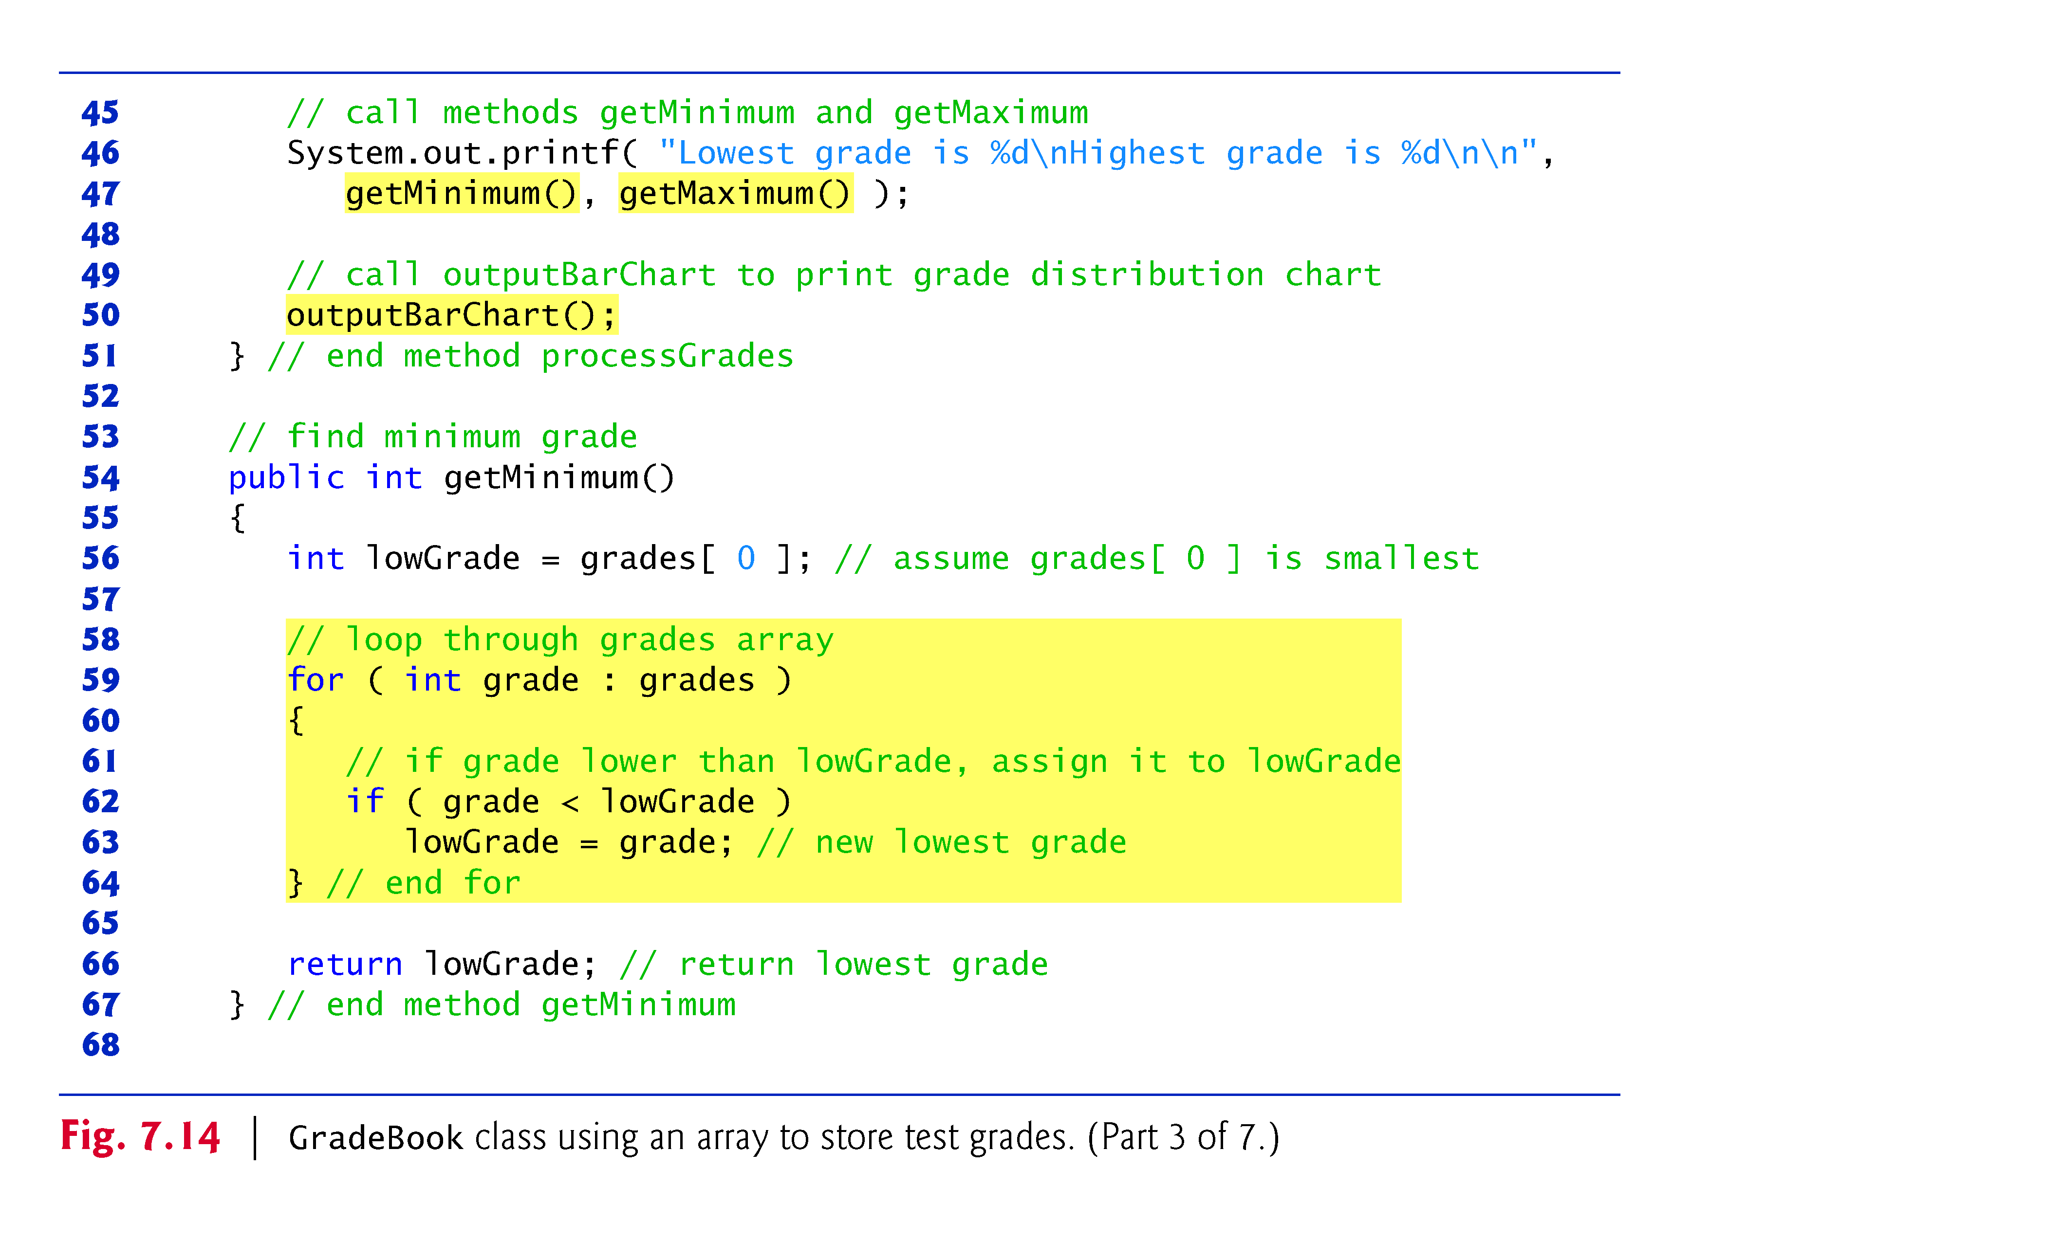
© Copyright 1992-2012 by Pearson Education, Inc. All Rights Reserved.

Slide 57
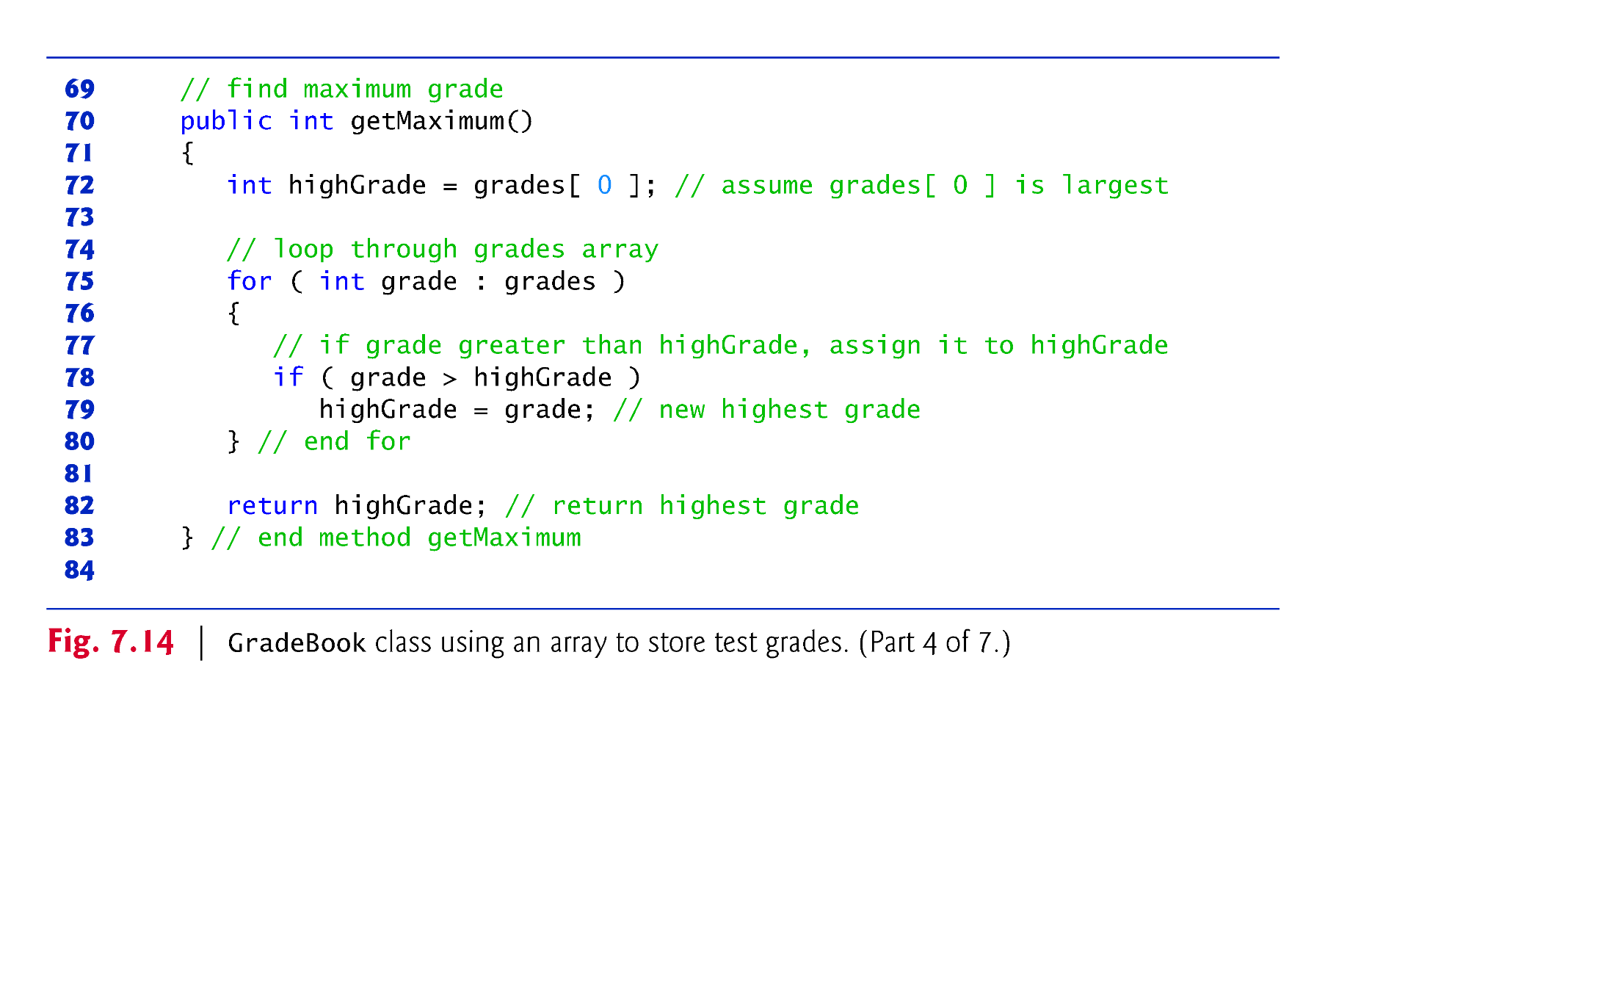
© Copyright 1992-2012 by Pearson Education, Inc. All Rights Reserved.

Slide 58
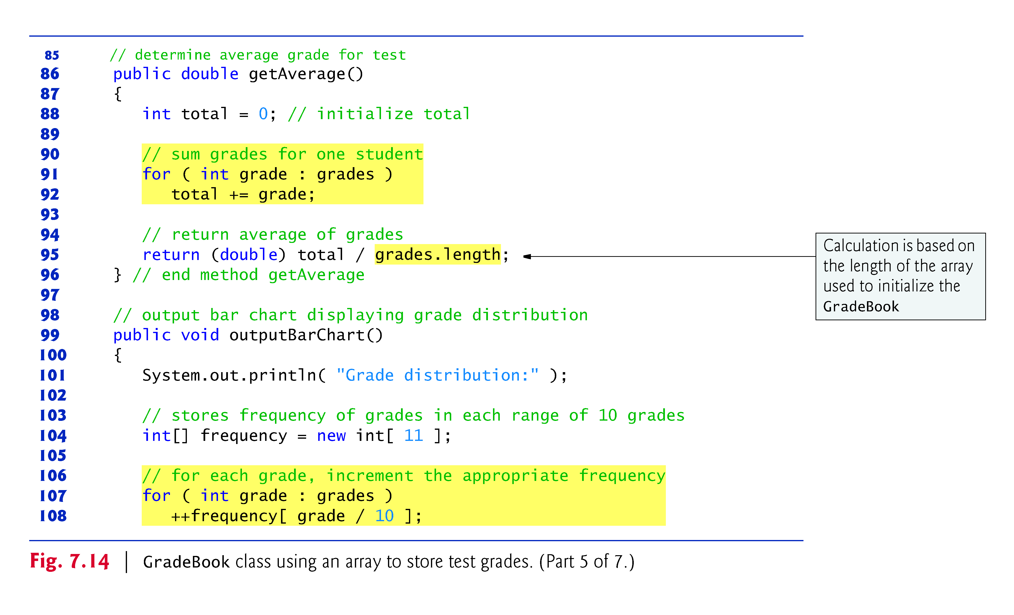
© Copyright 1992-2012 by Pearson Education, Inc. All Rights Reserved.

Slide 59
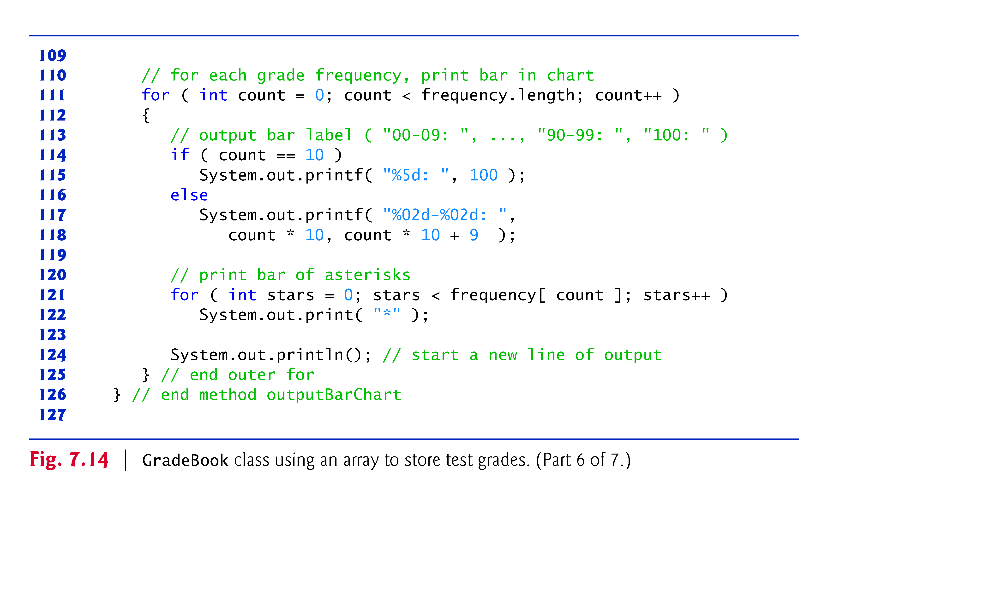
© Copyright 1992-2012 by Pearson Education, Inc. All Rights Reserved.

Slide 60
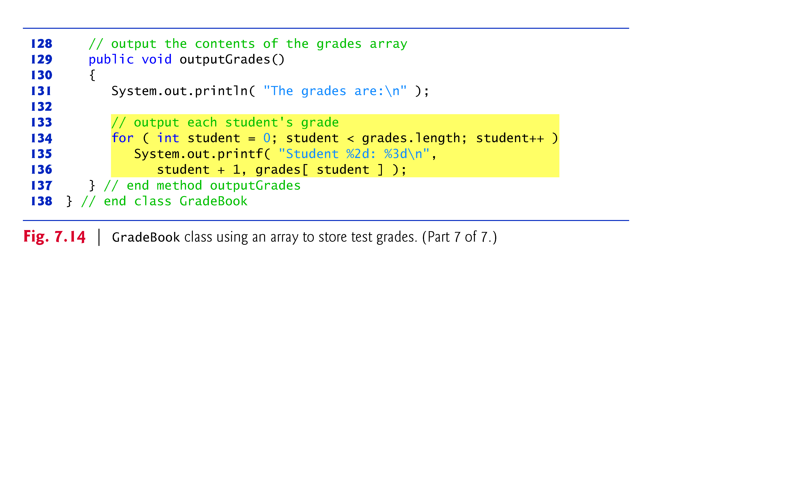
© Copyright 1992-2012 by Pearson Education, Inc. All Rights Reserved.

Slide 61
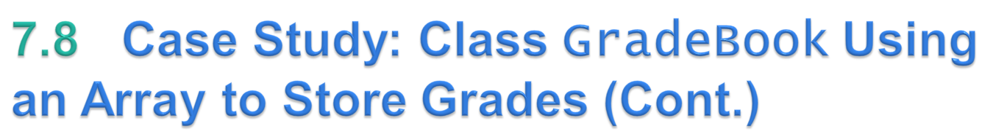
The application of Fig. 7.15 creates an object of class GradeBook (Fig. 7.14) using the int array grades-Array.
Lines 12–13 pass a course name and gradesArray to the GradeBook constructor.
© Copyright 1992-2012 by Pearson Education, Inc. All Rights Reserved.

Slide 62
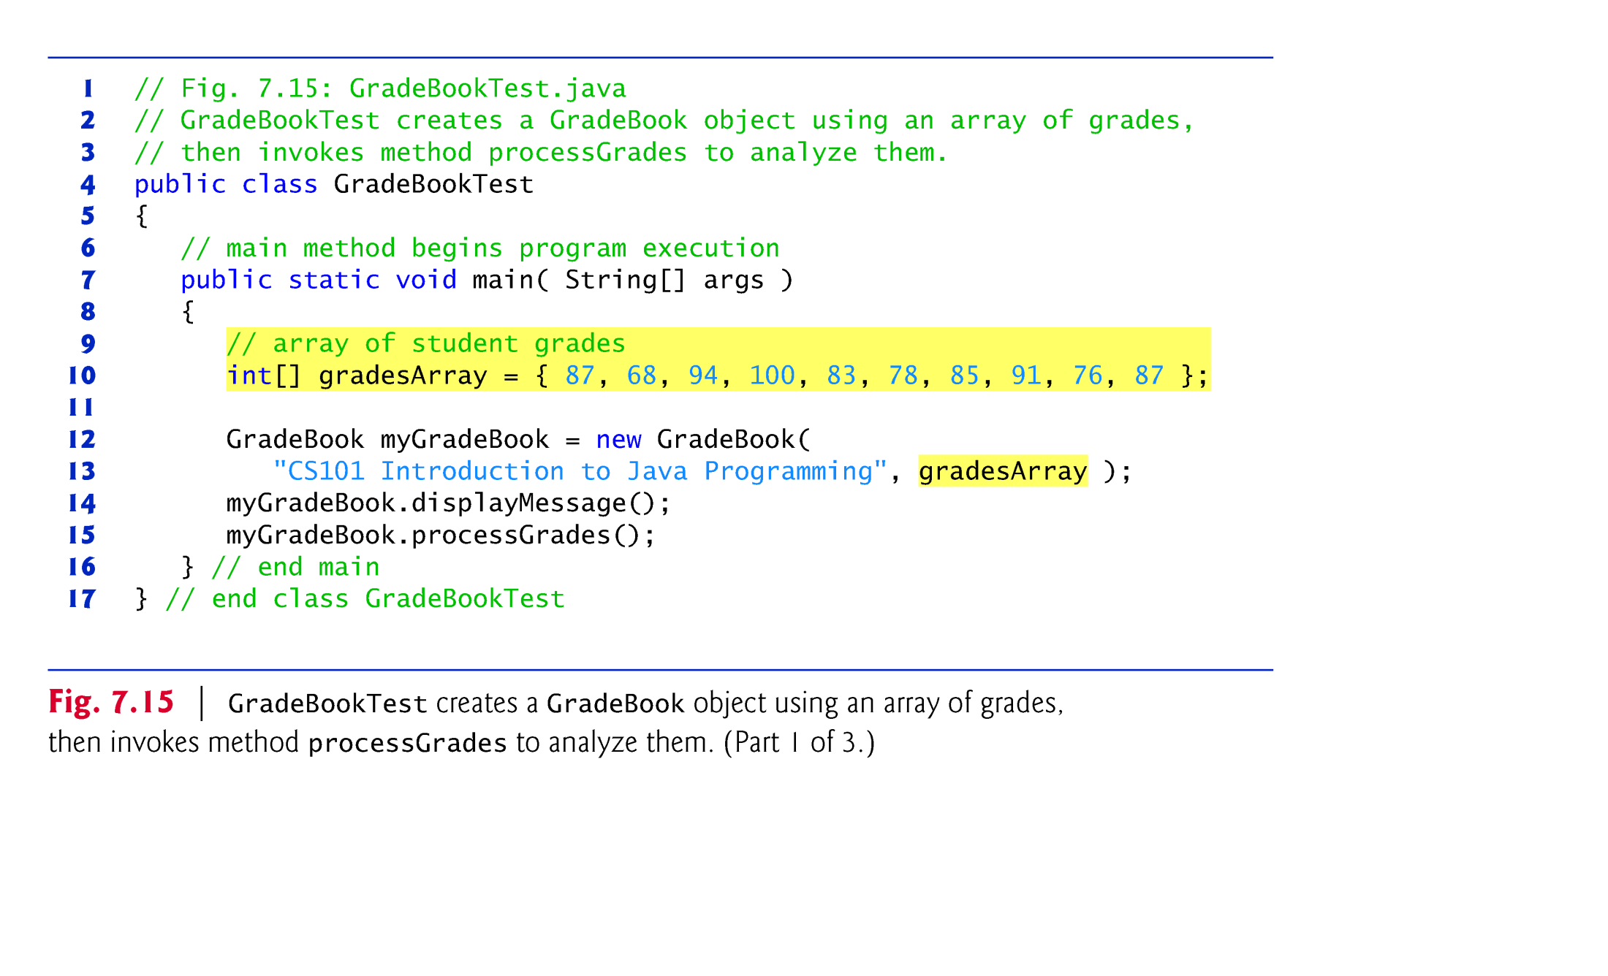

Slide 63
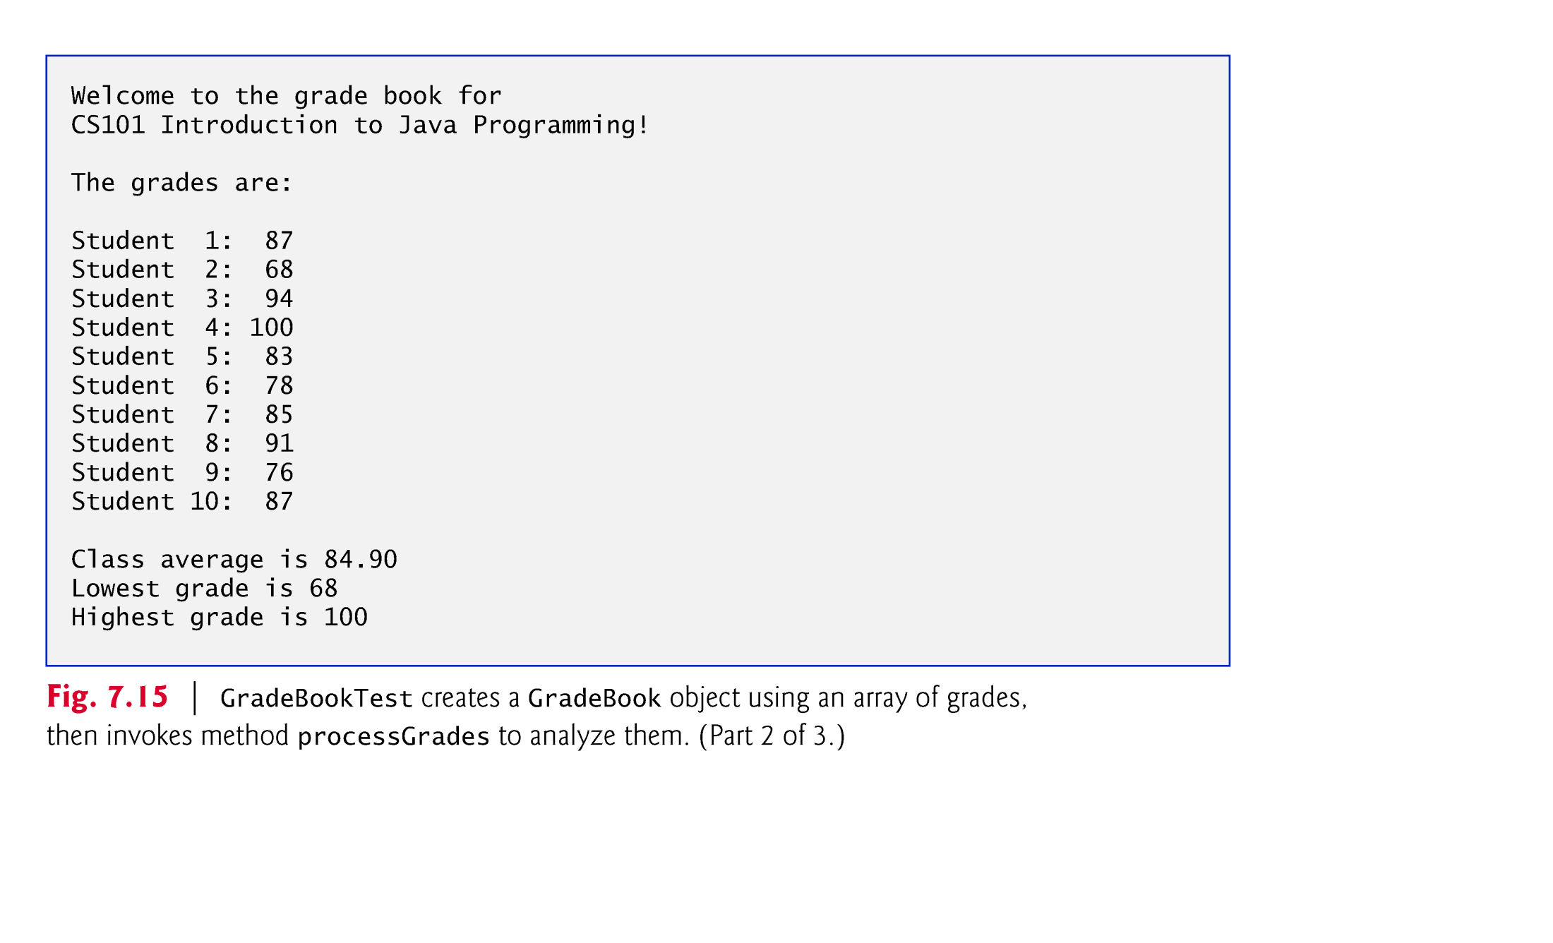

Slide 64


Slide 65
Copying Arrays
MANDATORY: Refer to the following topic in ‘Liang’ Book for a discussion of creating a shallow copy/deep copy of an array.
  Topic 7.5
Refer to the following online article for a discussion of different alternates of creating a deep copy of an array in JAVA.
  https://www.softwaretestinghelp.com/java-copy-array/#:~:text=You%20can%20use%20a%20for,()%20methods%20of%20Arrays%20class.
© Copyright 1992-2012 by Pearson Education, Inc. All Rights Reserved.

Slide 66
Exercises
Book: Liang
Case study7.4: Deck of Cards
© Copyright 1992-2012 by Pearson Education, Inc. All Rights Reserved.

Slide 67
Two-dimensional arrays are often used to represent tables of values consisting of information arranged in rows and columns.
Identify a particular table element with two indices.
  By convention, the first identifies the element’s row and the second its column.
Multidimensional arrays can have more than two dimensions.
Java does not support multidimensional arrays directly
  Allows you to specify one-dimensional arrays whose elements are also one-dimensional arrays, thus achieving the same effect.
In general, an array with m rows and n columns is called an m-by-n array.
© Copyright 1992-2012 by Pearson Education, Inc. All Rights Reserved.

Slide 68
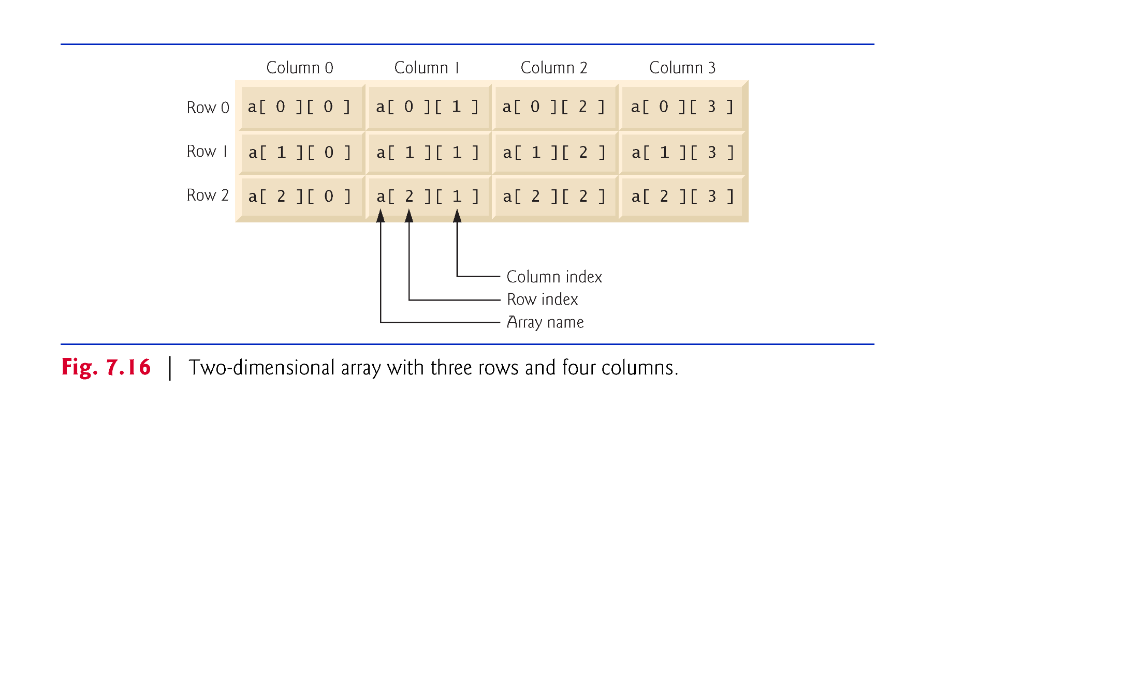
© Copyright 1992-2012 by Pearson Education, Inc. All Rights Reserved.

Slide 69
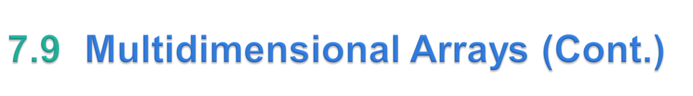
Multidimensional arrays can be initialized with array initializers in declarations.
A two-dimensional array b with two rows and two columns could be declared and initialized with nested array initializers as follows:
    int[][] b = { { 1, 2 }, { 3, 4 } };
  The initial values are grouped by row in braces.
  The number of nested array initializers (represented by sets of braces within the outer braces) determines the number of rows.
  The number of initializer values in the nested array initializer for a row determines the number of columns in that row.
  Rows can have different lengths.
© Copyright 1992-2012 by Pearson Education, Inc. All Rights Reserved.

Slide 70
The lengths of the rows in a two-dimensional array are not required to be the same:
    int[][] b = { { 1, 2 }, { 3, 4, 5 } };
  Each element of b is a reference to a one-dimensional array of int variables.
  The int array for row 0 is a one-dimensional array with two elements (1 and 2).
  The int array for row 1 is a one-dimensional array with three elements (3, 4 and 5).
© Copyright 1992-2012 by Pearson Education, Inc. All Rights Reserved.

Slide 71
A multidimensional array with the same number of columns in every row can be created with an array-creation expression.
    int[][] b = new int[ 3 ][ 4 ];
  3 rows and 4 columns.
The elements of a multidimensional array are initialized when the array object is created.
A multidimensional array in which each row has a different number of columns can be created as follows:
    int[][] b = new int[ 2 ][ ]; // create 2 rows
    b[ 0 ] = new int[ 5 ]; // create 5 columns for row 0
    b[ 1 ] = new int[ 3 ]; // create 3 columns for row 1
  Creates a two-dimensional array with two rows.
  Row 0 has five columns, and row 1 has three columns.
© Copyright 1992-2012 by Pearson Education, Inc. All Rights Reserved.

Slide 72
Figure 7.17 demonstrates initializing two-dimensional arrays with array initializers and using nested for loops to traverse the arrays.
© Copyright 1992-2012 by Pearson Education, Inc. All Rights Reserved.

Slide 73
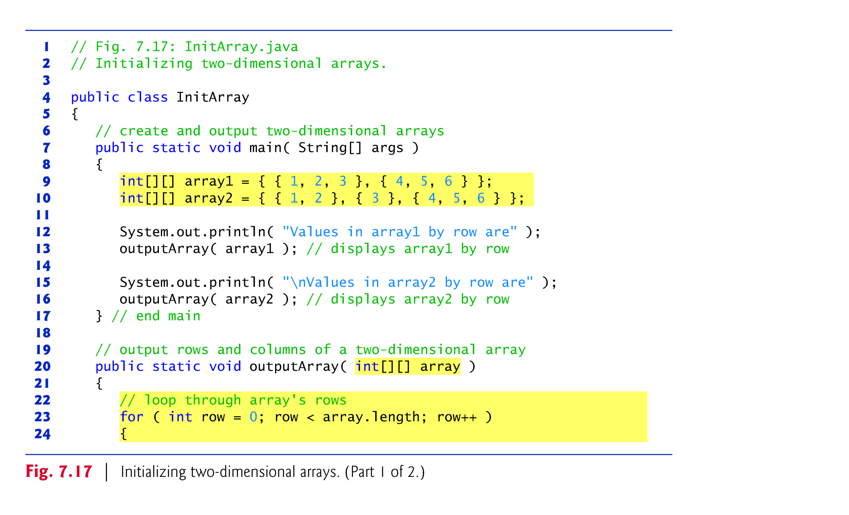

Slide 74
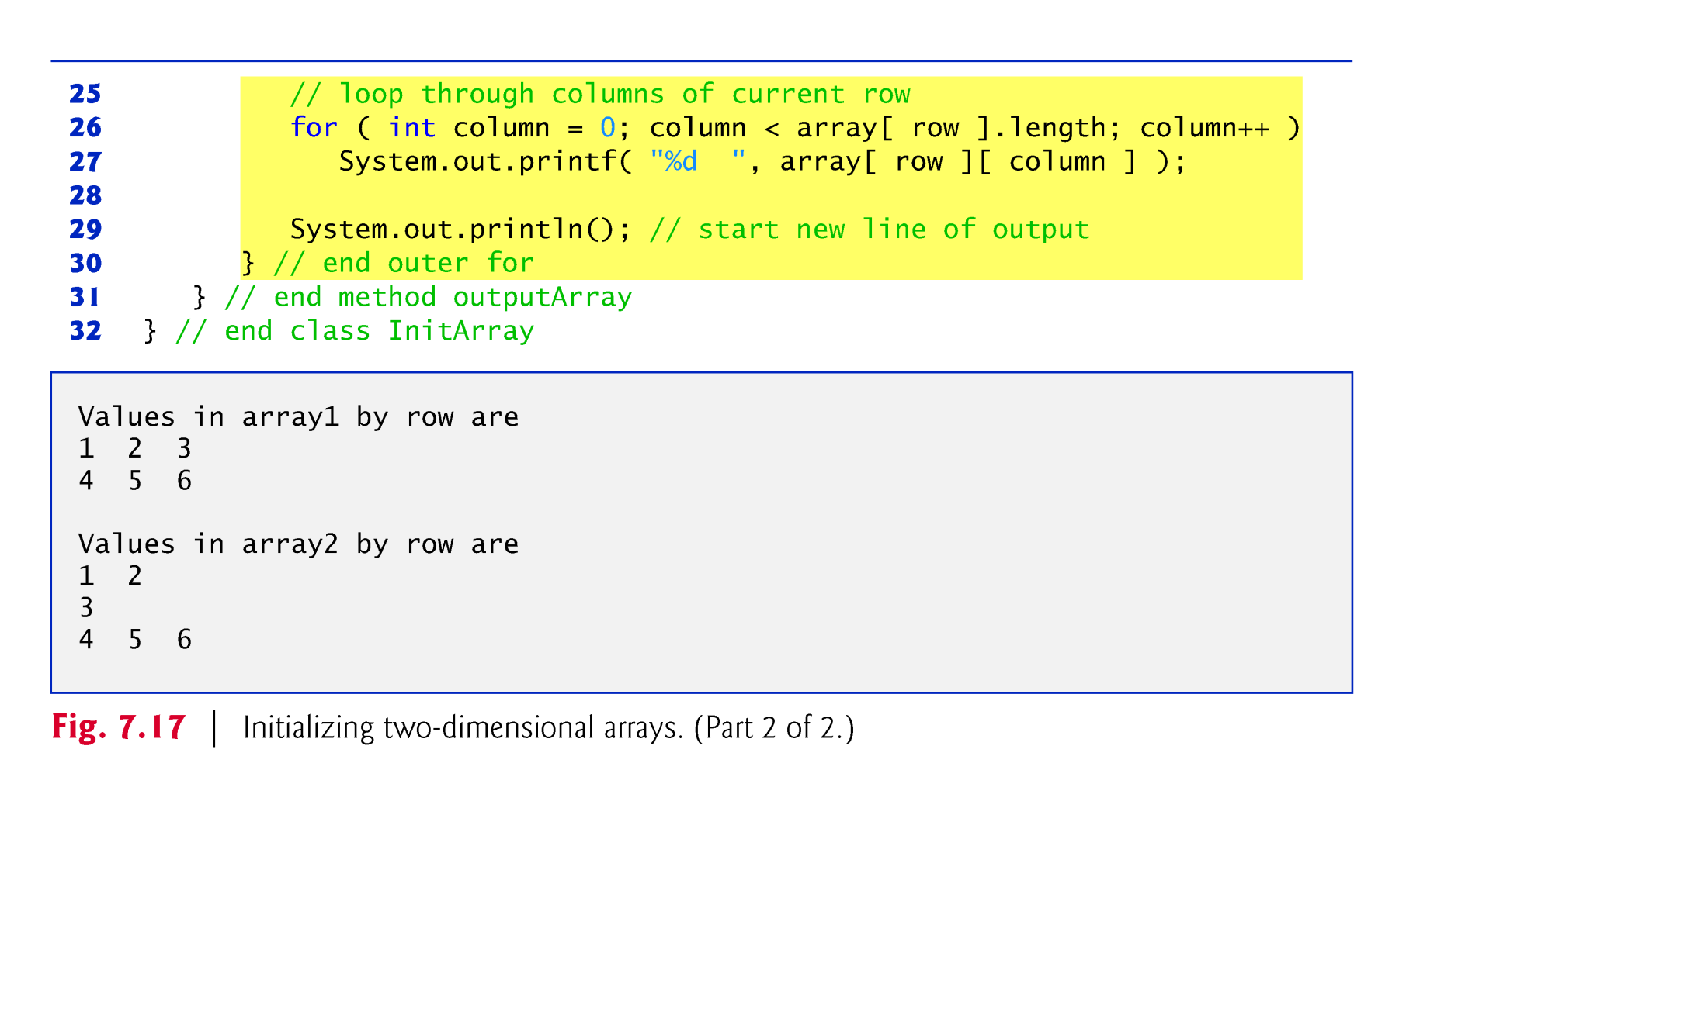

Slide 75
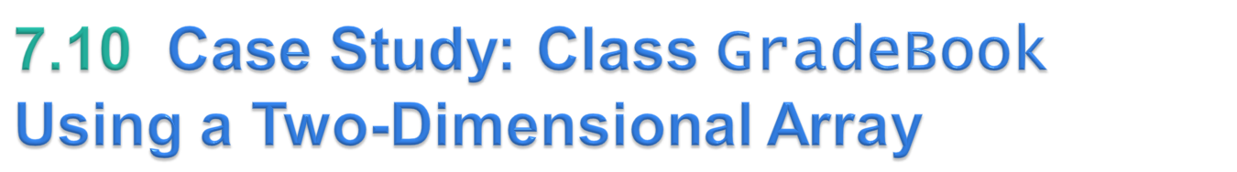
In most semesters, students take several exams.
Figure 7.18 contains a version of class GradeBook that uses a two-dimensional array grades to store the grades of a number of students on multiple exams.
  Each row represents a student’s grades for the entire course.
  Each column represents the grades of all the students who took a particular exam.
In this example, we use a ten-by-three array containing ten students’ grades on three exams.
© Copyright 1992-2012 by Pearson Education, Inc. All Rights Reserved.

Slide 76
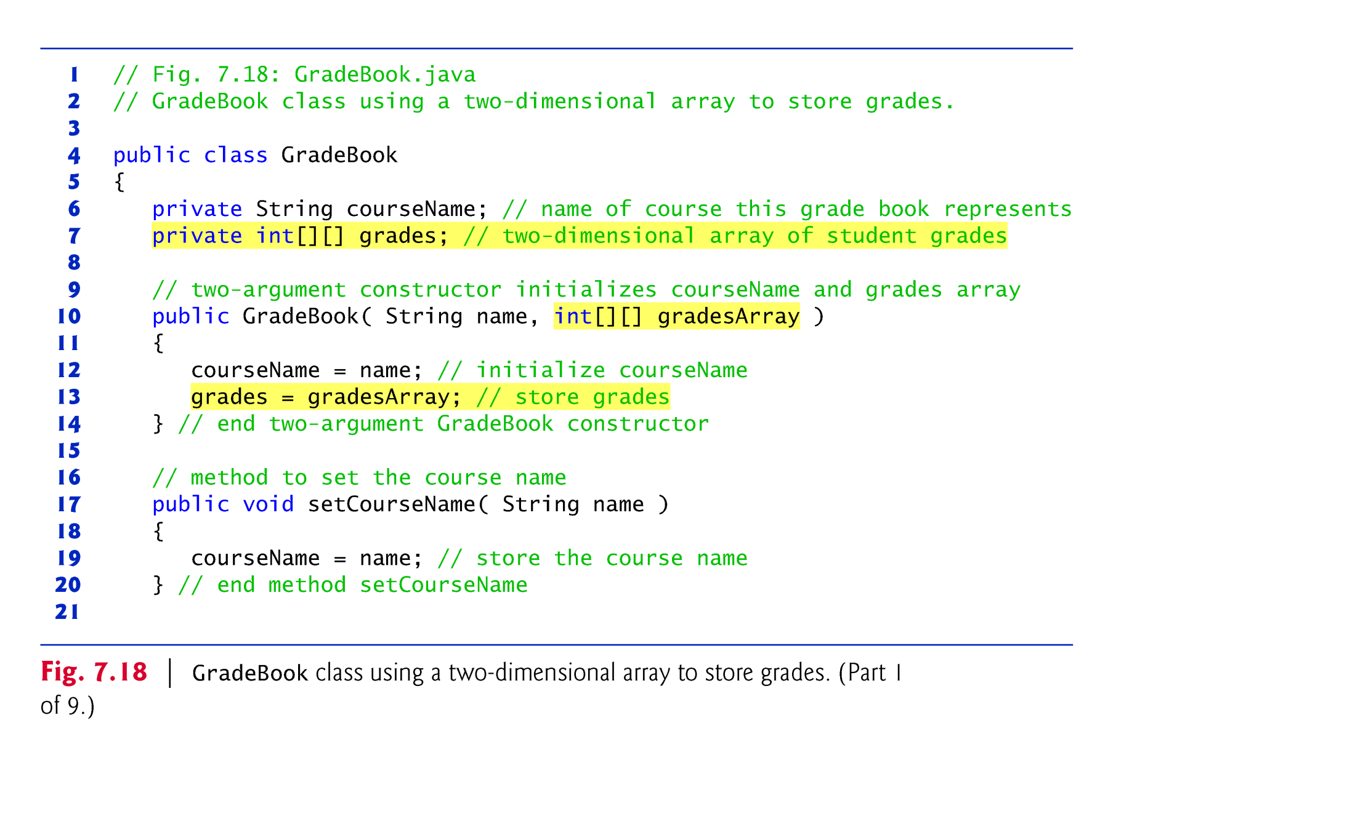

Slide 79
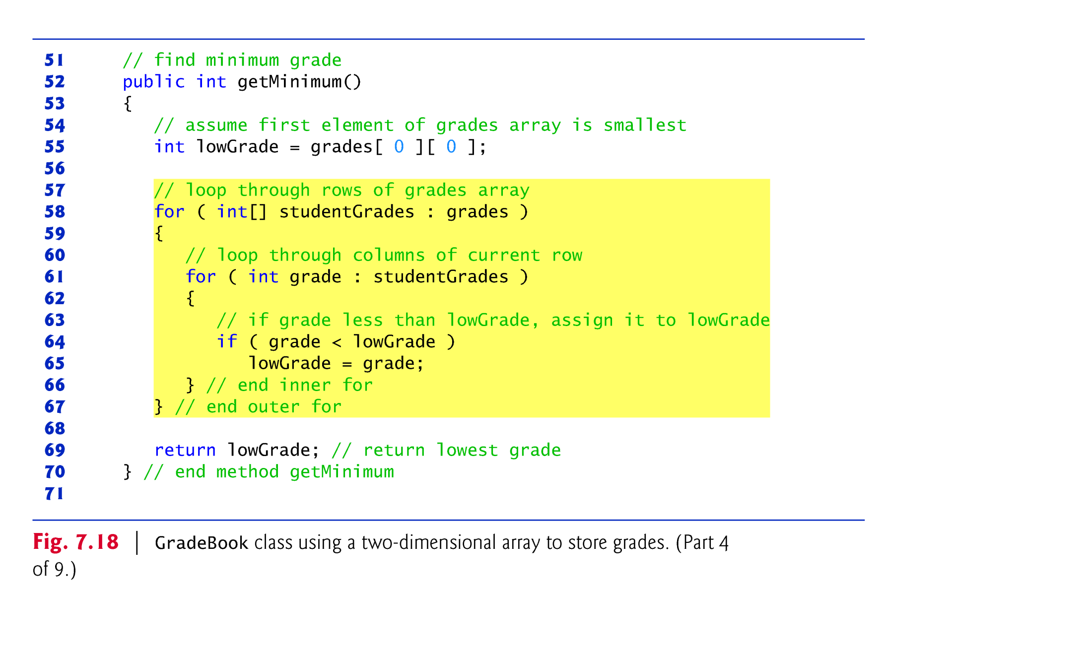
What if we need to find the lowest grade of each student?
What if we need to find the lowest grade in each exam?
  Note: We need to return a 1D array in both cases.

Slide 87


Slide 88
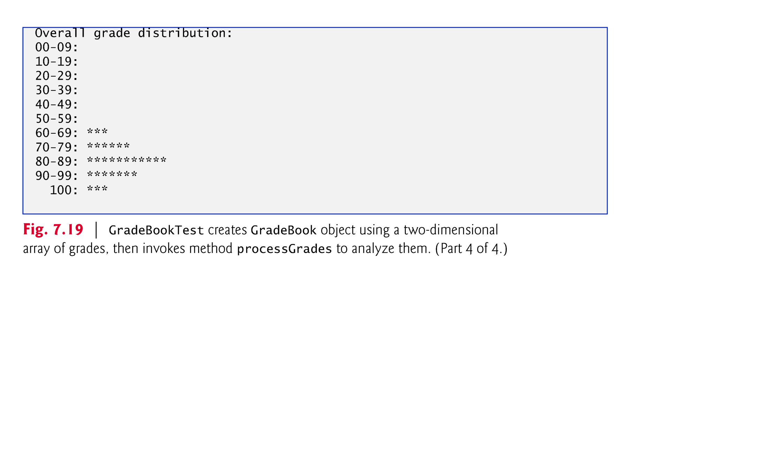

Slide 89
Exercises
Book: Liang
Case study 8.5: Grading MCQs
Case study 8.6: Finding the closes pair
* Case study 8.7: Sudoku Game
* Case study 8.8.1: Weather reporting
* Case study 8.8.2: Guessing birthdays
© Copyright 1992-2012 by Pearson Education, Inc. All Rights Reserved.

Slide 90
Exercises
© Copyright 1992-2012 by Pearson Education, Inc. All Rights Reserved.

Slide 91
Exercises
Book: Liang
Programming Exercise 8.2
Programming Exercise 8.5
© Copyright 1992-2012 by Pearson Education, Inc. All Rights Reserved.

